Slide 1

Soil property estimation using a cosmic-ray neutron rover?
Trenton Franz
Acknowledgements:
Justin Gibson (PhD), Catie Finkenbiner (MS), William Avery (MS), Matt Russell (Undergrad), Tiejun Wang (Research Scientist)
May 24th, 2017

Slide 2
Take home messages
Society cares about past, present and future water fluxes (i.e. recharge, runoff, evapotranspiration, irrigation)

Slide 3
Take home messages
Society cares about past, present and future water fluxes (i.e. recharge, runoff, evapotranspiration, irrigation)
Soil moisture/tension observations are necessary for:
a) simultaneously constraining fluxes and soil hydraulic/thermal properties
    b) frequently updating land surface model states for improved forecast skill

Slide 4
Take home messages
Society cares about past, present and future water fluxes (i.e. recharge, runoff, evapotranspiration, irrigation)
Soil moisture/tension observations are necessary for:
a) simultaneously constraining fluxes and soil hydraulic/thermal properties
    b) frequently updating land surface model states for improved forecast skill
EOF is a robust statistical framework to scale sparse regional SM networks

Slide 5
Take home messages
Society cares about past, present and future water fluxes (i.e. recharge, runoff, evapotranspiration, irrigation)
Soil moisture/tension observations are necessary for:
a) simultaneously constraining fluxes and soil hydraulic/thermal properties
    b) frequently updating land surface model states for improved forecast skill
EOF is a robust statistical framework to scale sparse regional SM networks
CRNP rover offers an additional environmental covariate for spatio-temporal predictions of soil properties and states across scales

Slide 6
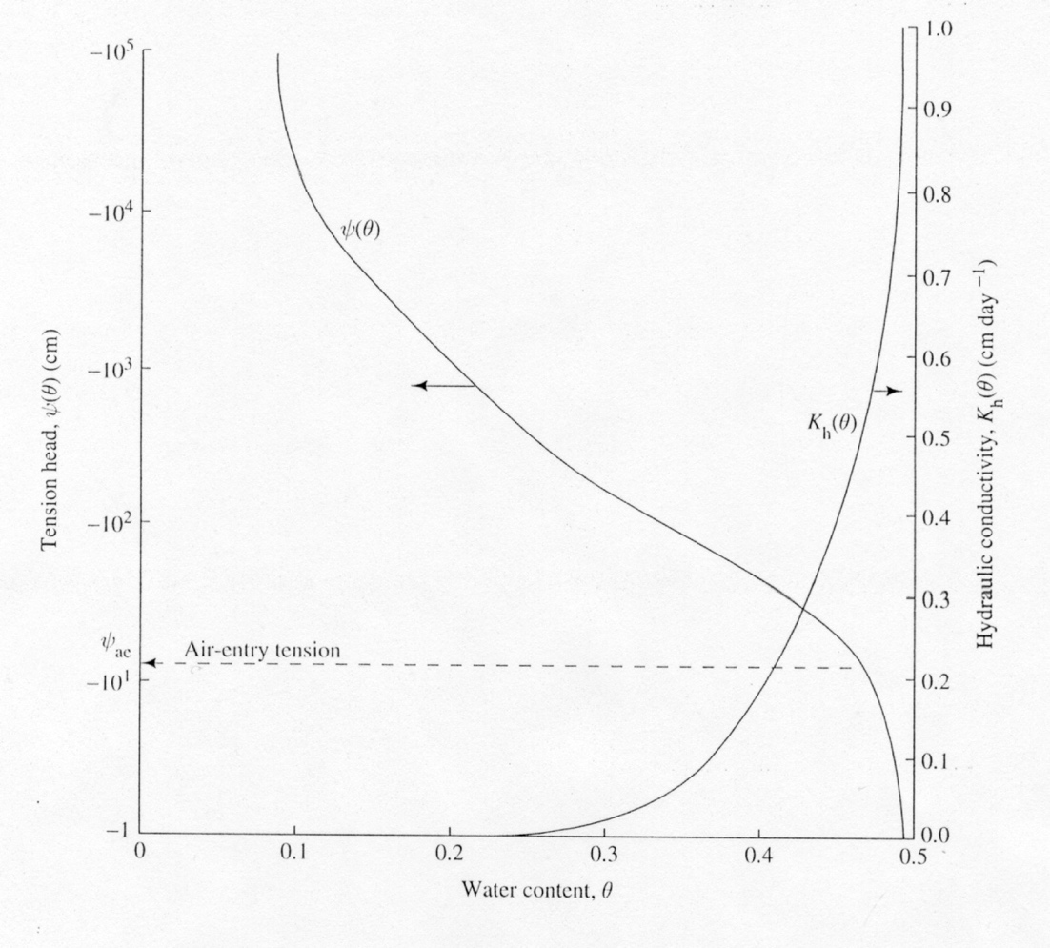
1D Richards Equation
where $θ$ is volumetric water content (cm³/cm³), t is time (day), z is the spatial location (cm), K($θ$) is unsaturated hydraulic conductivity (cm/day), h is pressure head (cm), and S is a sink term describing evapotranspiration (1/day).

Slide 7
Organization of Soil Moisture
Center-pivot Scale
Sprinkler Scale
Crow et al., 2012, Jana 2010

Slide 8
Measurement tools are limiting
TDR Sensor Array
1 year
1 month
1 day
1 hour
1 minute
1 m
100 m
10 km
1000 km
Adapted from Robinson (2008)

Slide 9
Measurement tools are limiting
TDR Sensor Array
Satellite Remote Sensing
1 year
1 month
1 day
Airborne Remote Sensing
1 hour
1 minute
1 m
100 m
10 km
1000 km
Adapted from Robinson (2008)

Slide 10
Measurement tools are limiting
TDR Sensor Array
Satellite Remote Sensing
Mobile TDR & EM
1 year
1 month
1 day
Airborne Remote Sensing
1 hour
1 minute
Cosmic-ray Probe and Rover
1 m
100 m
10 km
1000 km
Adapted from Robinson (2008)

Slide 11
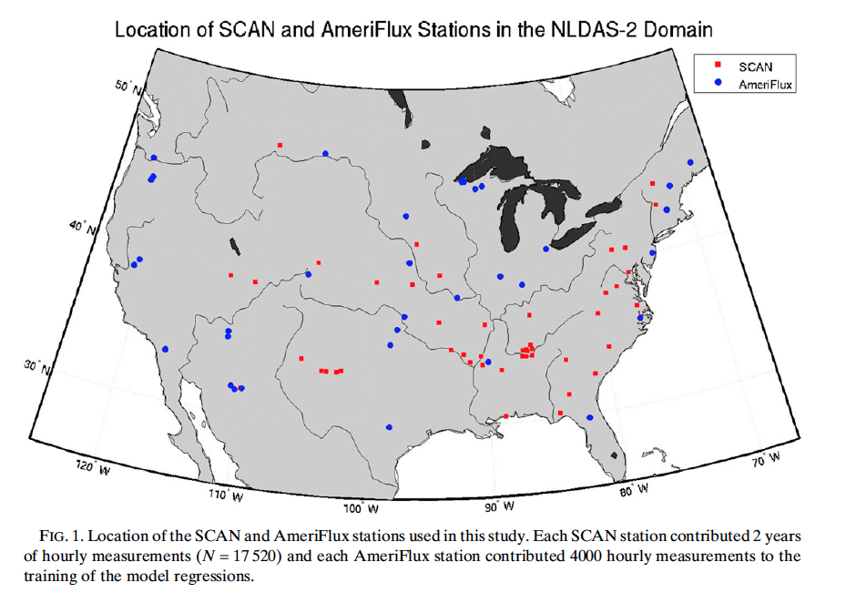
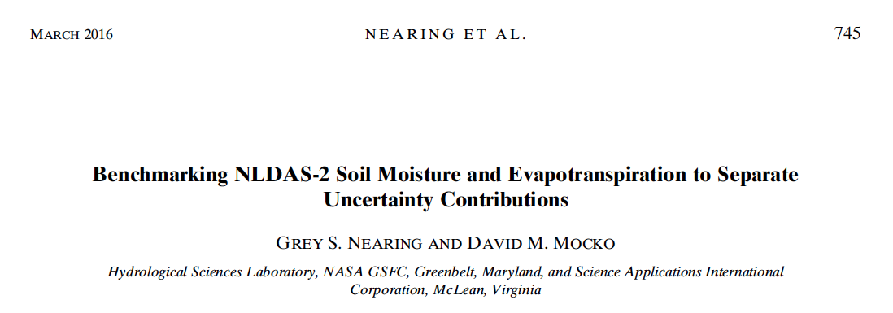
Weather Forecasting

Slide 12
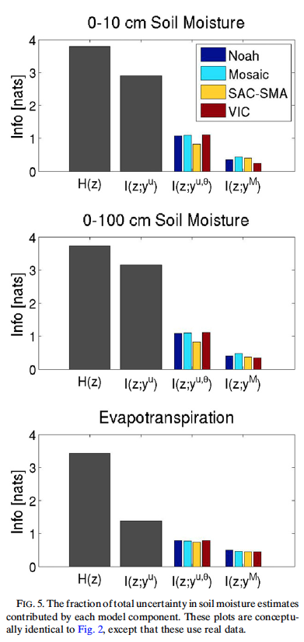
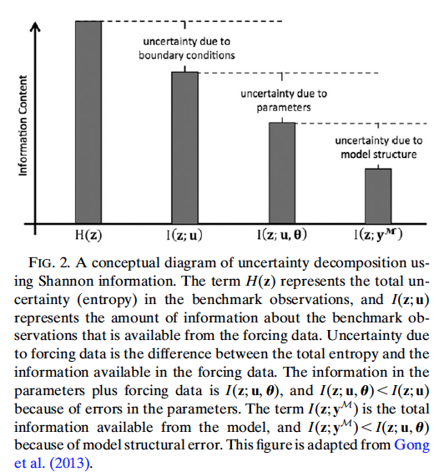
Uncertainty Analysis

Slide 13
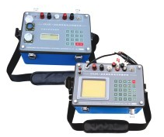
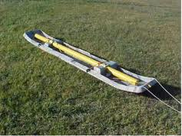
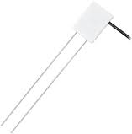
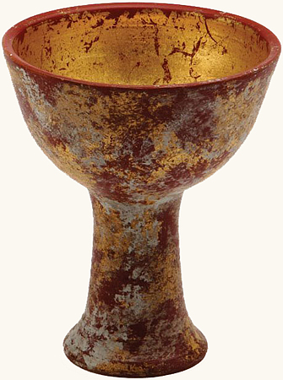
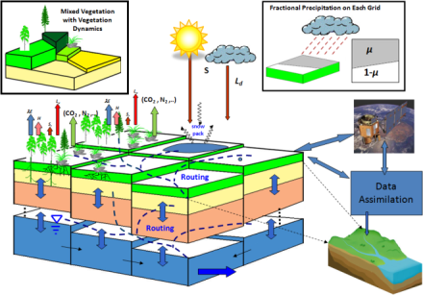
Motivation

Slide 14
Motivation
Quantify flux (uncertainty + parameters) at scale consistent with models

Slide 15
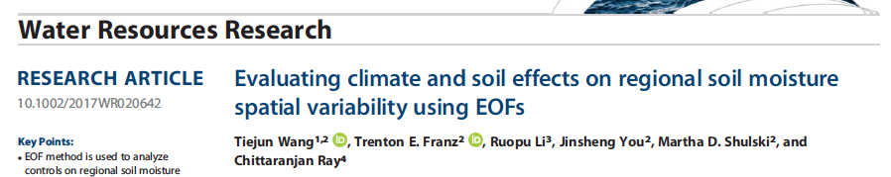
Study 1: Regional Soil Moisture Networks
What controls the spatial variability of regional soil moisture patterns?
Can we use identified environmental covariates to scale sparse regional networks?

Slide 16
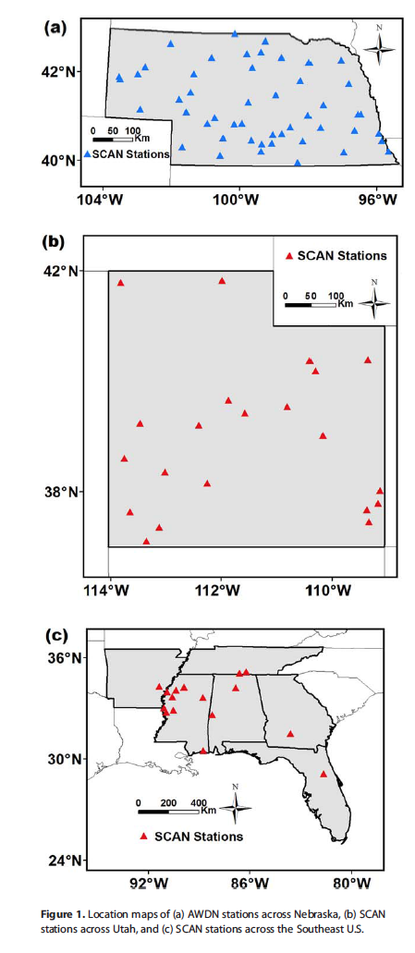
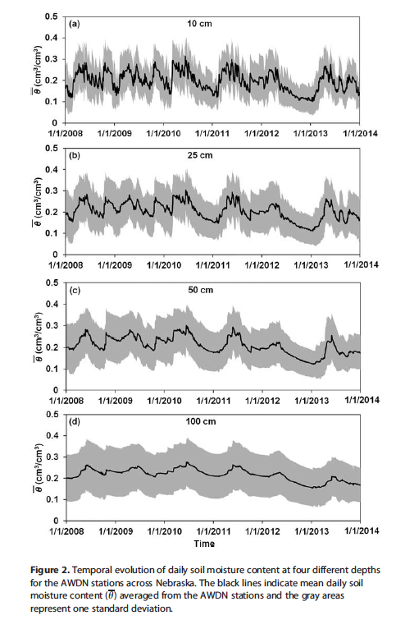
Study 1: Regional Soil Moisture Networks

Slide 17
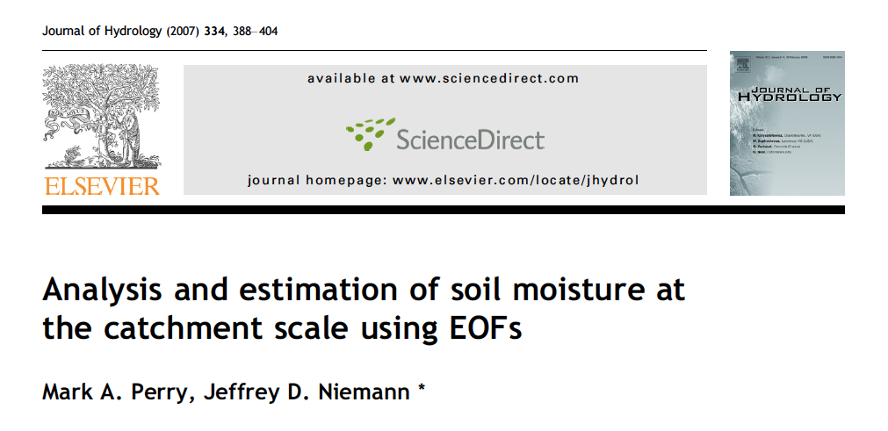
Use EOF framework to seperate spatial and temporal soil moisture anomalies
  Spatial loadings map (EOFs) can be used to group sites of “like” soil moisture states
  Spatial moments of point sensors can be used to describe temporal varying component (ECs)
  Combine reduced number of spatial (EOFs) and time varying loadings (EC) to reconstruct spatial patterns across space and time
V*E = L*E

Slide 18
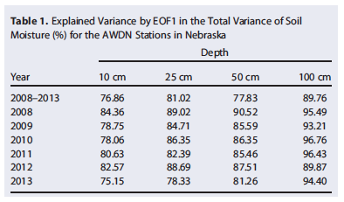
Study 1: Spatial Component (EOF) vs. Environmental Covariates

Slide 19
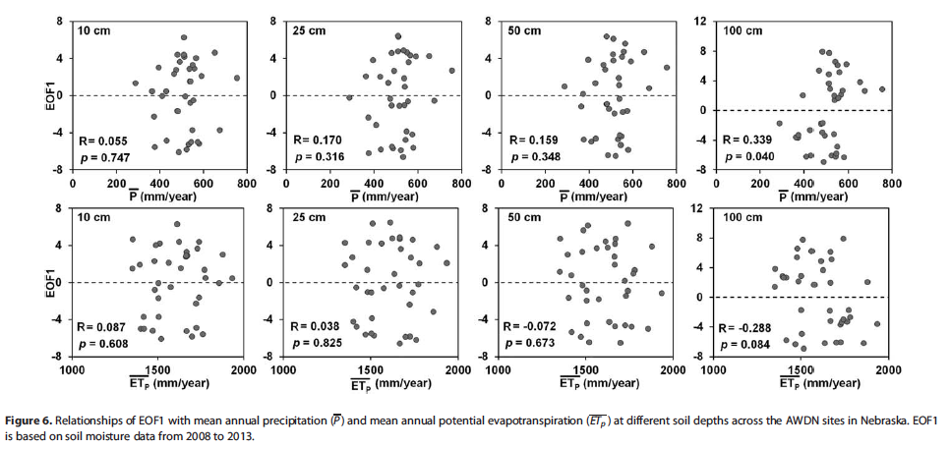
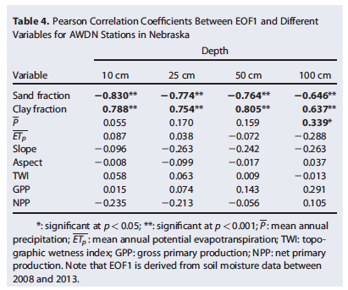
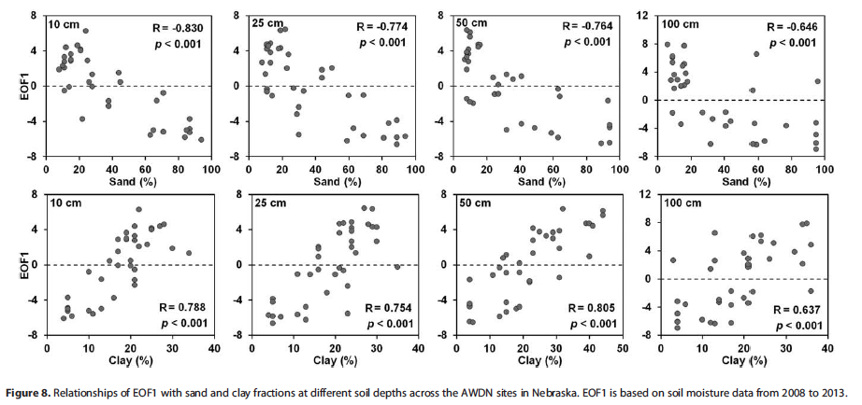
Study 1: Spatial Component (EOF) vs. Environmental Covariates

Slide 20
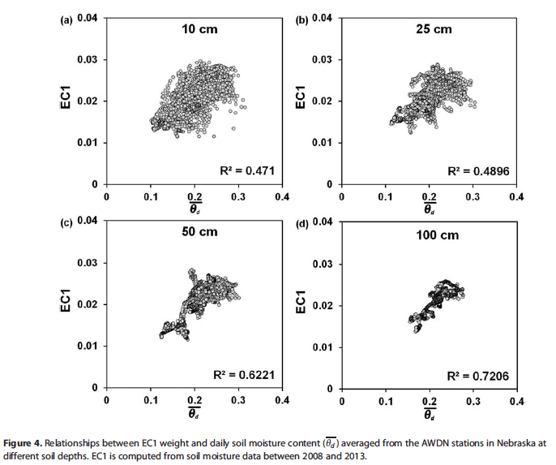

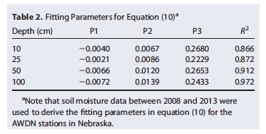
Study 1: Temporal Loadings (EC)

Slide 21
Study 1: Regional Soil Texture Properties
1 km product from Shangguan et al. 2014

Slide 22
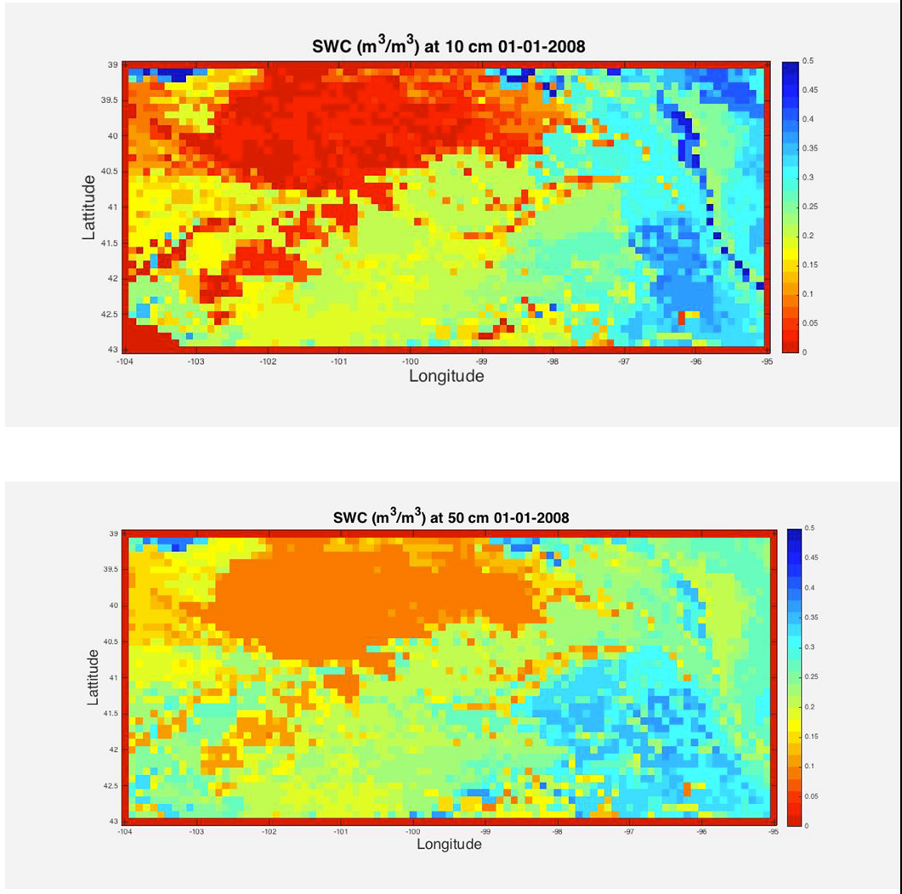
Study 1: Regional Soil Moisture Networks

Slide 23
Study 1: Regional Soil Moisture Networks Summary
1. EOF allows us to scale sparse regional soil moisture networks across space and time with environmental covariates
2. Identified EOF coefficients + network spatial moments can be used to make realtime and operational products to support data assimilation for LSMs
3. Opportunity for State/National Mesonets to collaborate with LSM, remote sensing, and operational forecast community

Slide 24

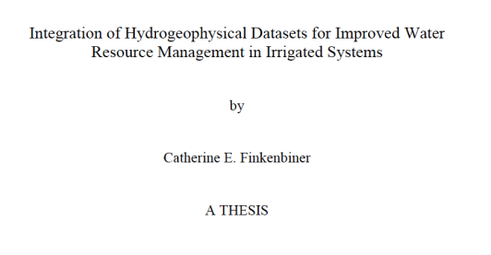
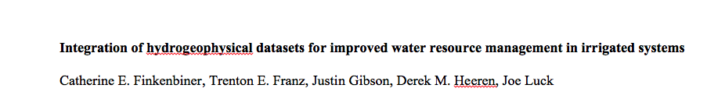
Study 2: Support of Precision Agriculture
How can we best use CRNP to support precision agriculture?
Can the technology provide cost effective spatial information to make a management decision?
In review, Precision Agriculture

Slide 25
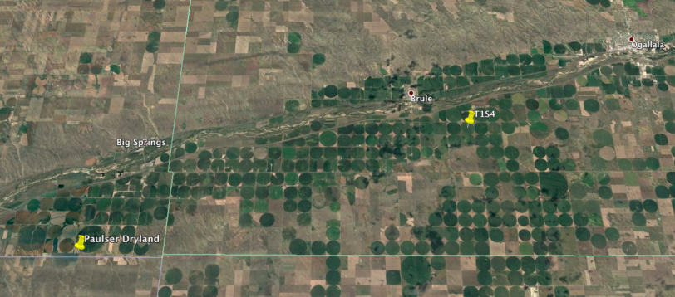
Study 2: Irrigation Scheduling 101
Need to know size of soil bucket (field capacity and wilting point) and relative soil moisture status through time (trigger irrigation halfway between)

Slide 26
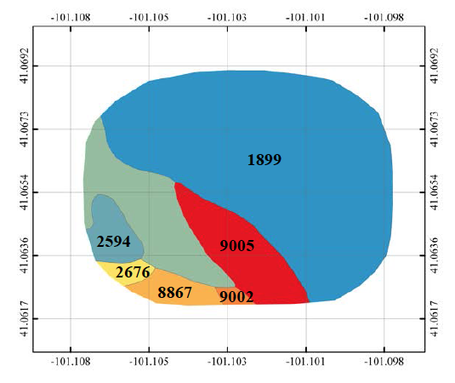
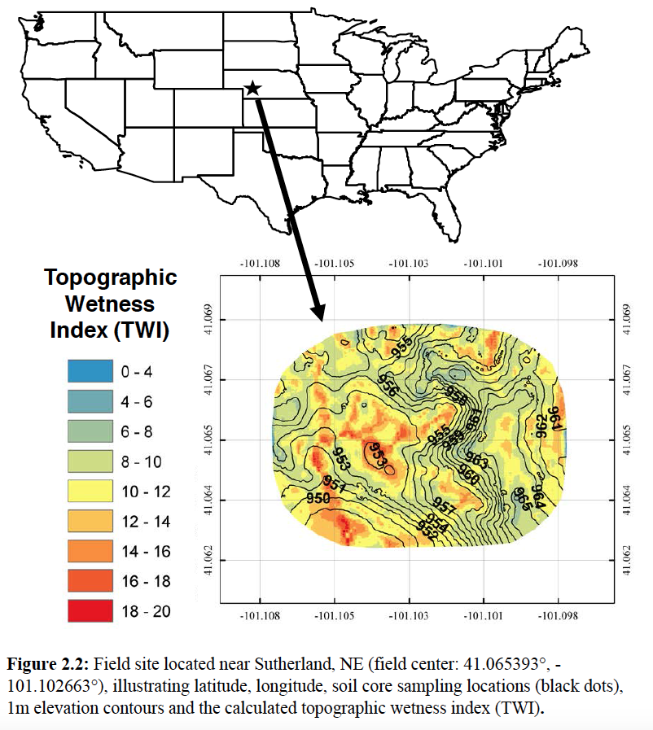
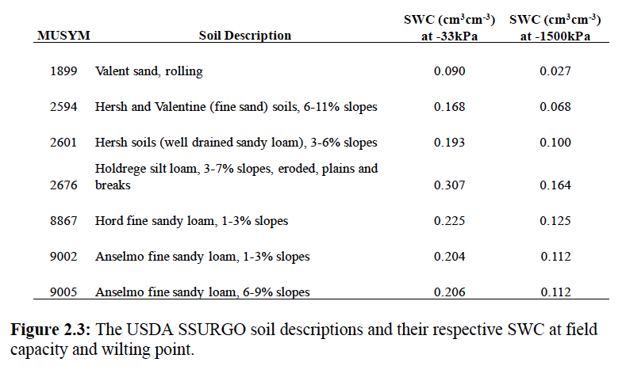
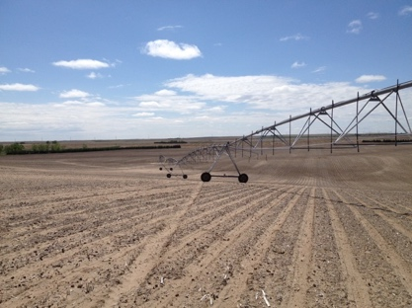
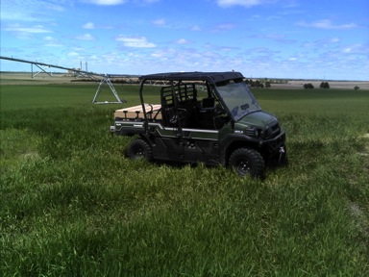
Paulman Farms located near Sutherland, NE
Center-pivot irrigated corn
Notes:
Our field site is located at Paulman Farms near Sutherland, NE. It is a center pivot irrigated corn field with ~60ft elevation increase as you travel from west to east. The field is predominantly sand with some sandy loams, and silt loams. The top 30cm of the SSURGO soil database were averaged to approximate field capacity for the field. The field capacity estimates are summarized in the table.

Slide 27
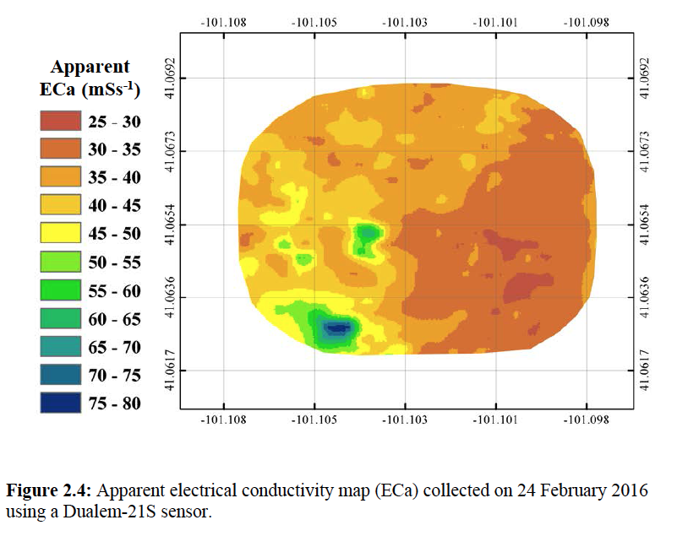
Hydrogeophysical Mapping

Slide 28
EOF Example
EOF/EC | Explained Spatial Variance
1 | 79.6
2 | 5.6
*Needed 4 surveys to estimate EOF1 coefficients

Slide 29
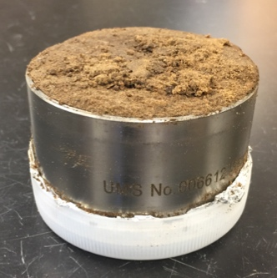
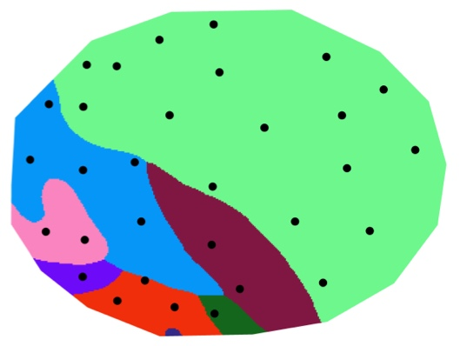
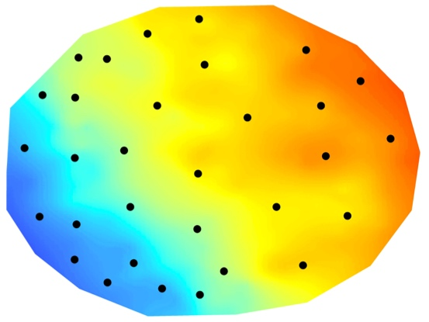
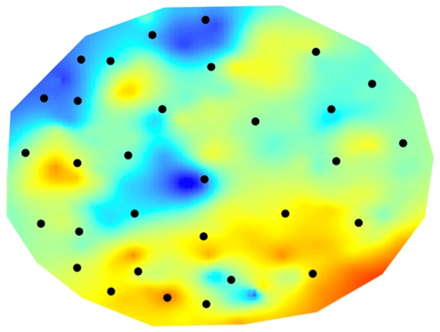
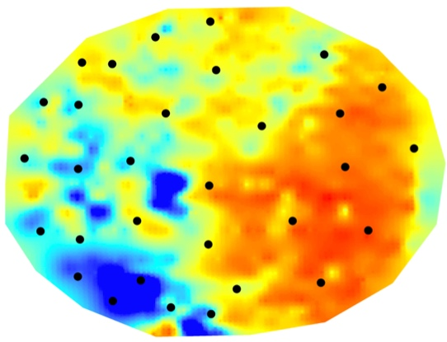
Soil Sampling
Collected 31 undisturbed soil cores at 20cm depth
Sample locations chosen based on SSURGO soil boundaries, EOFs, and EM surveys
Samples were placed in a cooler in the field and then stored in a freezer at the lab
SSURGO
EOF1
EOF2
ECa
Notes:
We collected 31 undisturbed soil cores at a 20cm soil depth. The sample locations were chosen based on SSURGO soil boundaries, EOFs and EM surveys. Our goal was to select sample locations from a range of values from each map. Samples were placed in a cooler in the field and then stored in a freezer at the lab until they were analyized.

Slide 30
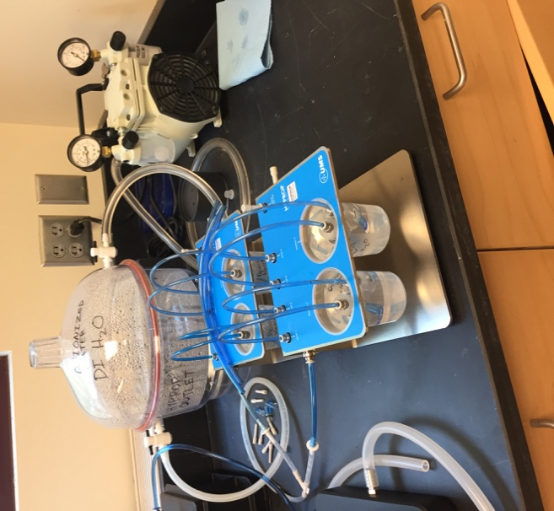
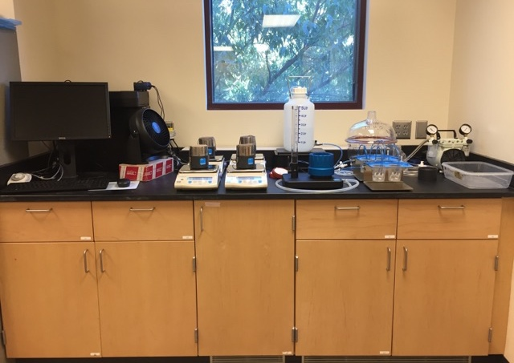
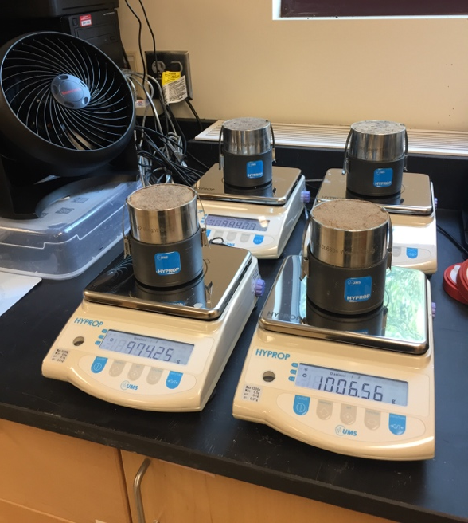
Calculating Field Capacity/ Wilting Point
Decagon HYPROP
Records mass change and change in tension
Notes:
We used a Decagon HYPROP to create water retention curves to approximate field capacity for our soil samples.
Wet sample to saturation
Remove air from DI water in tensiometer
Insert tensiometer in soil core and record mass change and change in tension as soil dries
Estimate Field Capacity at -6 kPa and -33kPa

Slide 31
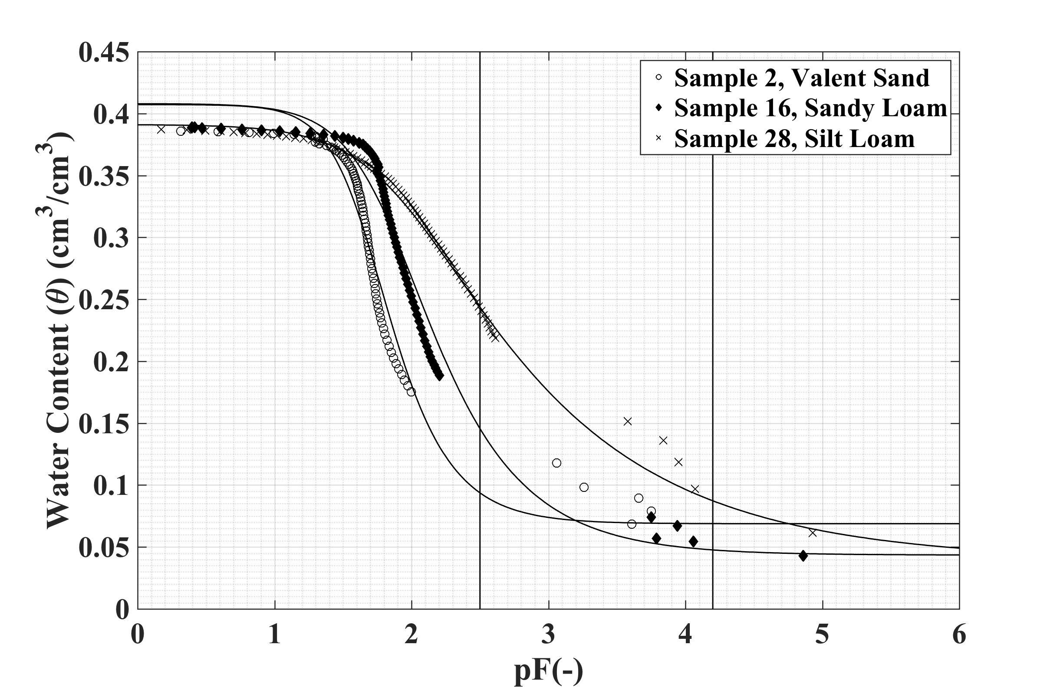
Soil Water Retention Curve Generated by HYPROP Software
Field Capacity
Available water
Wilting Point
Notes:
This is an example of one of the soil water retention curves created using the decagon HYPROP software. After I stopped running the sample, I oven dried it and weighed it to calculate it’s bulk density and porosity. Since the sample started at saturation, we assumed the water content at the start of the experiment was equal to porosity. We fit our data using the van Genuchten model. Field capacity water content estimates were calculated at 6kPa and 33kPa.

Slide 32
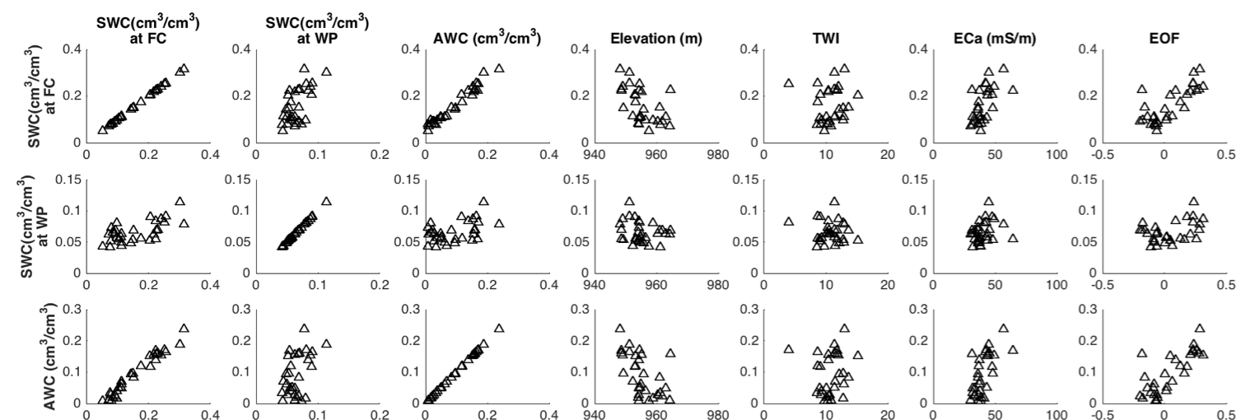
Notes:
The binned mean values could be used for zone averaged irrigation management. P-value

Slide 33
Spatial Products Useful for Irrigators
WP
Notes:
Here is a new field capacity product I created for our field site. This product can be used to make prescription irrigation maps for the field that better characterize the soil spatial heterogeneity within the field.
Wetness Index! SSURGO with FC values

Slide 34
Study 2: Precision Agriculture Summary
CRNP mapping + EOF is best environmental covariate predictor of lab derived soil properties
Economically viable (?) for high value crops or areas with severe water allocation
Notes:
Here is a new field capacity product I created for our field site. This product can be used to make prescription irrigation maps for the field that better characterize the soil spatial heterogeneity within the field.
Wetness Index! SSURGO with FC values

Slide 35
Take home messages
Society cares about past, present and future water fluxes (i.e. recharge, runoff, evapotranspiration, irrigation)
Soil moisture/tension observations are necessary for:
a) simultaneously constraining fluxes and soil hydraulic/thermal properties
    b) frequently updating land surface model states for improved forecast skill
EOF is a robust statistical framework to scale sparse regional SM networks
CRNP rover offers an additional environmental covariate for spatio-temporal predictions of soil properties and states across scales

