Slide 1
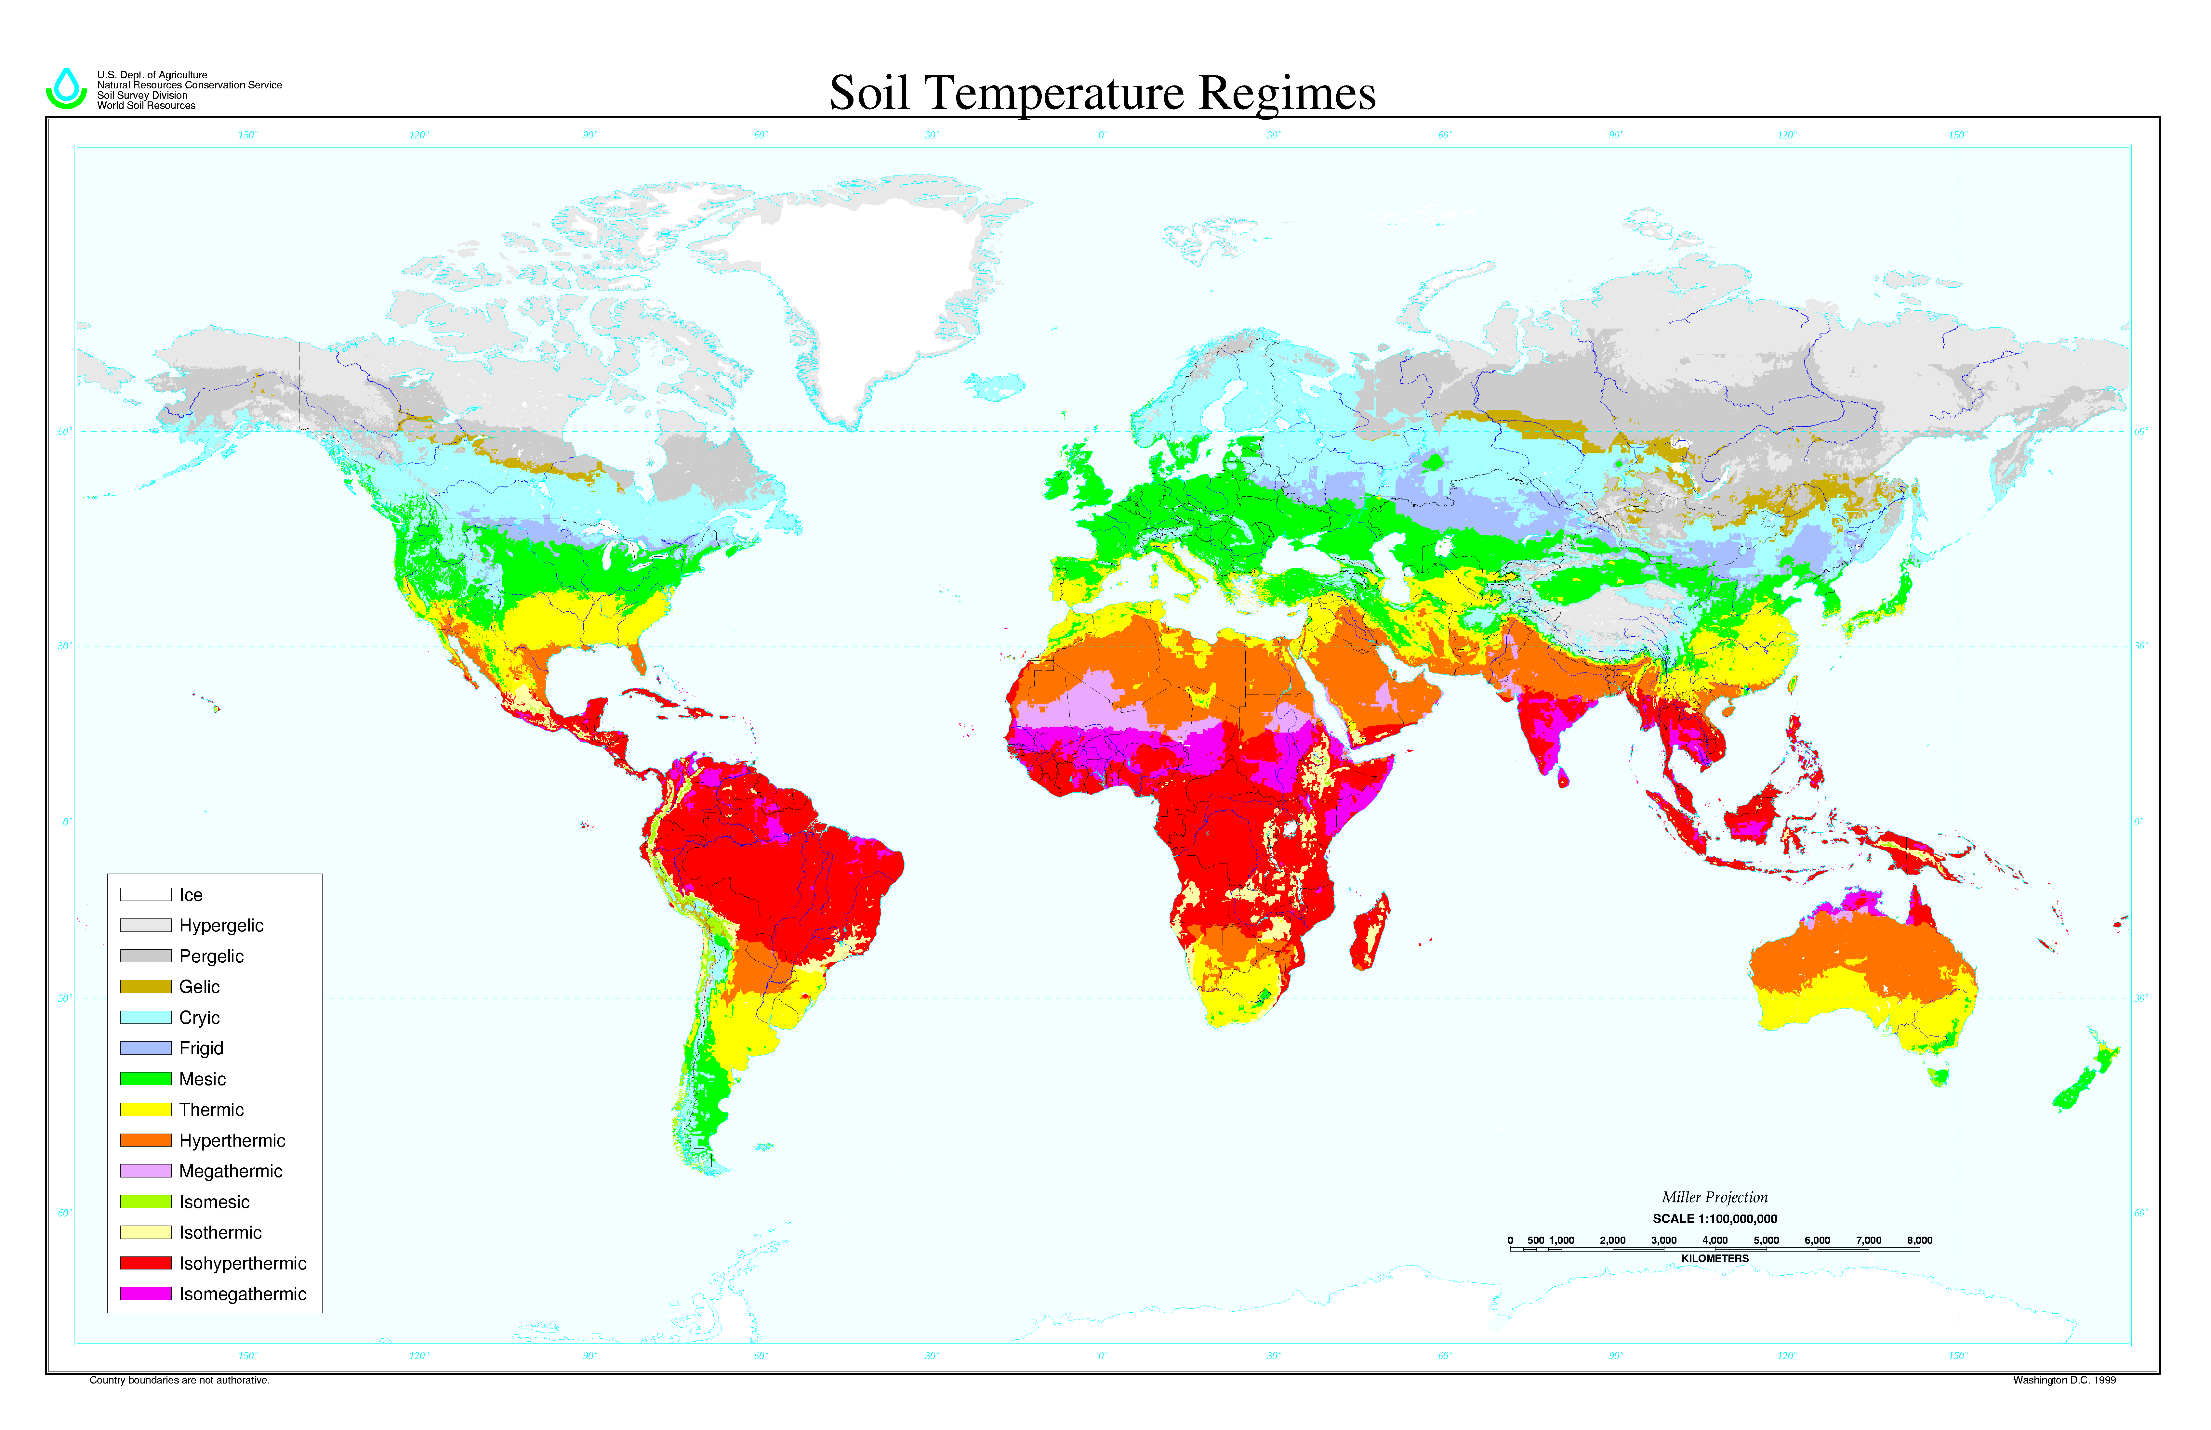
Soil temperature and energy balance

Slide 2
Temperature
a measure of the average kinetic energy of the molecules of a substance
that physical property which determines the direction of heat flow between two substances in thermal contact
not a measure of heat content

Slide 3
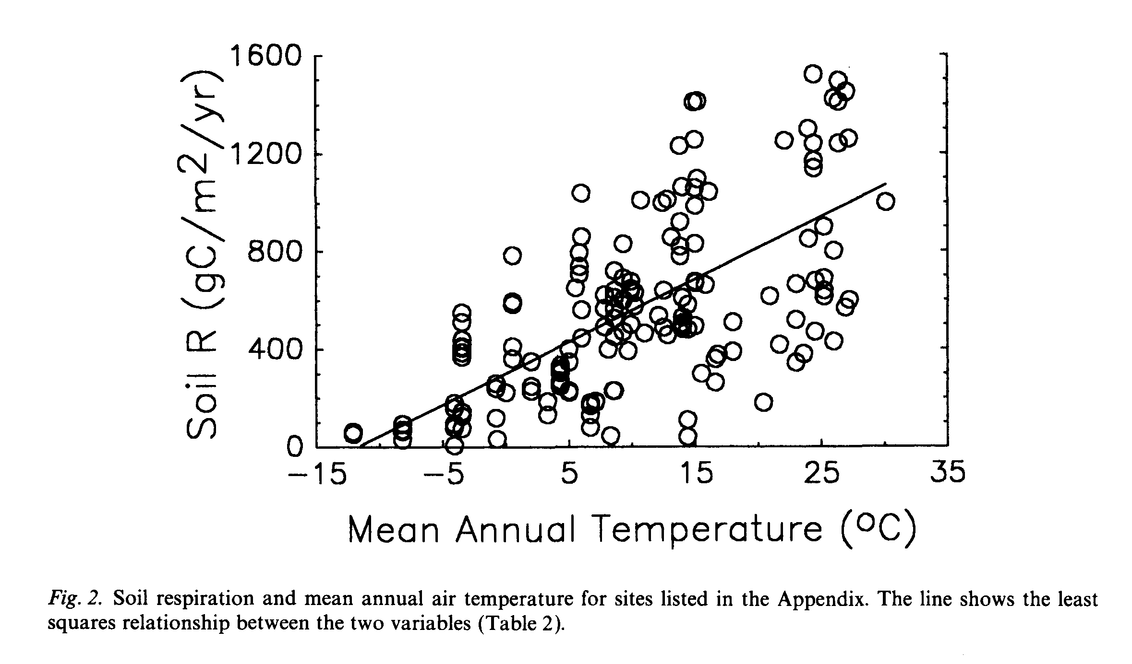
RAICH, J.W., and W.H. SCHLESINGER. 1992. The global carbon dioxide flux in soil respiration and its relationship to vegetation and climate. Tellus B 44:81-99.

Slide 4
Modes of energy transfer
radiation: emission of energy in the form of electromagnetic waves
conduction: transfer of heat by molecular motion
convection: heat transfer by bulk fluid motion

Slide 5
Radiation
Stefan-Boltzmann law
J_{t} = total radiant flux
= emissivity
= 1 for a “black body”; 0.9 to 1.0 for soil
σ = Stefan-Boltzmann constant
= 5.67 x 10⁻⁸ W m⁻² K⁻⁴
T = temperature of the emitter (K)

Slide 6
Radiation
Wien’s law
λ_{m} = wavelength of maximum radiation intensity

Slide 7
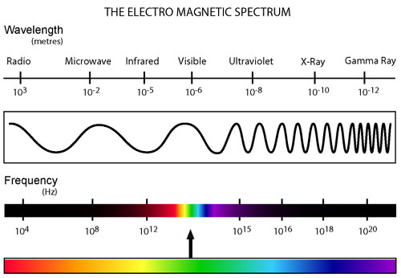
http://www.atmos.washington.edu/~hakim/301/handouts.html

Slide 8
Radiation
short-wave radiation: the incoming solar spectrum
long-wave radiation: the spectrum emitted by the earth

Slide 9
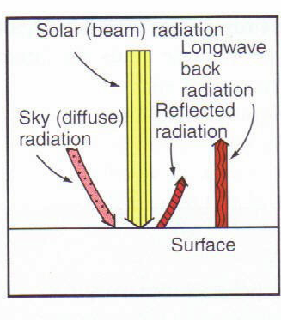
Net radiation at the soil surface
Net radiation = the sum of all incoming minus outgoing radiant energy fluxes

Slide 10
Net radiation at the soil surface
J_{n} = net radiation (W m⁻², J s⁻¹ m⁻²)
J_{s} = direct beam incoming short-wave
J_{a} = diffuse incoming short-wave
α = albedo = the fraction of incoming short-wave radiation reflected by the surface
J_{li} = incoming long-wave
J_{lo} = outgoing long-wave

Slide 11
Albedo
for soil it varies from 0.1 to 0.4 (unitless)
depends on:
  soil color
  surface roughness
  sun angle
  soil moisture

Slide 12
Surface energy balance
For the soil surface layer (infinitely thin), energy in = energy out
J_{n} = net radiation at the surface
S = heat flux into the soil
A = sensible heat flux to the atmosphere
L = latent heat of vaporization (J kg⁻¹)
  temperature dependent, 2.4 x 10⁶ J kg⁻¹ @ 25°C
E = rate of evaporation (mm d⁻¹, kg m⁻² d⁻¹)

Slide 13
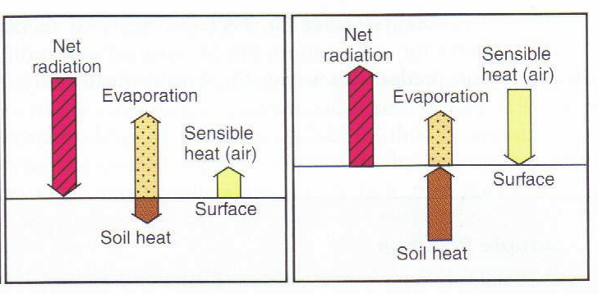
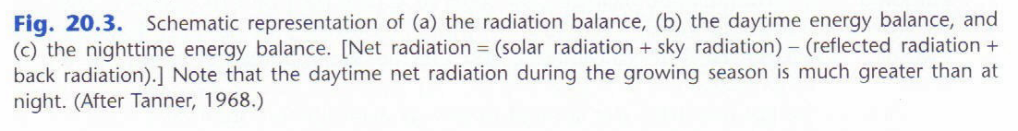
Surface energy balance

Slide 14
Energy balance components measured above a corn residue covered soil surface in 1994 at a site near Ames, Iowa. Net radiation (Rn) is positive toward the surface. The other terms are positive away from the soil surface. Adapted from Sauer et al. (1998).

Slide 15
Calculate the direction and magnitude of the soil heat flux:
Incoming shortwave = 300 W m⁻²
Albedo = 0.15
Surface temperature = 25°C
Sensible heat flux = 0
Evaporation rate = 2 mm d⁻¹
Surface emissivity = 0.9
Atmosphere returns 60% of outgoing longwave

Slide 16
Heat conduction
Fourier’s Law: the heat flux is proportional to the temperature gradient
q_{h} = heat flux by conduction (W m⁻²)
κ = thermal conductivity (W m⁻¹ K⁻¹)
T = temperature (K or °C)
z = position (m)

Slide 17
Calculate the soil heat flux (W m⁻²)
soil thermal conductivity = 1.2 W m⁻¹ K⁻¹
temperature at 5 cm = 30 °C
temperature at 10 cm = 28 °C

Slide 18
Continuity equation
Change in energy storage equals energy in minus energy out
C = volumetric heat capacity (J m⁻³ K⁻¹)
D_{T} = thermal diffusivity = κ/C

Slide 19
Reading assignment
Soil thermal properties, p. 218-225

Slide 20
Soil thermal properties
Three primary thermal properties of soil
  volumetric heat capacity
  thermal conductivity
  thermal diffusivity
Applications
  used to predict soil temperatures
  used for measurement of soil moisture
  used for remote sensing applications

Slide 21
Volumetric heat capacity
the amount of energy required to raise the temperature of a unit volume of soil by 1 degree (J m⁻³ K⁻¹)
a linear function of soil water content and bulk density
c_{s} = specific heat of the soil solids (kJ kg⁻¹ K⁻¹)
c_{w} = specific heat of water (4.18 kJ kg⁻¹ K⁻¹)

Slide 23
Calculate the volumetric heat capacity
bulk density = 1300 kg m⁻³
gravimetric water content = 0.20 kg kg⁻¹
specific heat of the soil solids = 0.85 kJ kg⁻¹ K⁻¹

Slide 24
Thermal properties of clay loam soil as functions of volumetric water content. Reprinted from Ren et al. (1999).

Slide 25
Thermal conductivity
the ratio of the magnitude of the heat flux through the soil to the magnitude of the temperature gradient (W m⁻¹ K⁻¹)
a measure of the soil's ability to conduct heat
influenced by:
  texture, mineralogy, organic matter, density, water content, air-content, structure, water vapor in the pores, temperature

Slide 27
Thermal properties of clay loam soil as functions of volumetric water content. Reprinted from Ren et al. (1999).

Slide 28
Thermal properties of silica sand as functions of volumetric water content. Reprinted from Ren et al. (1999).

Slide 29
Thermal diffusivity
the ratio of the thermal conductivity to the volumetric heat capacity (m² s⁻¹) ; D_{T} = κ/C
a measure of the rate of transmission of a temperature change through the soil
influenced by:
  all that influences κ and C

Slide 30
Thermal properties of clay loam soil as functions of volumetric water content. Reprinted from Ren et al. (1999).

Slide 31
Reading assignment
Soil thermal regime, p. 227-233

Slide 32
Soil surface temperature
oscillations driven by the daily and yearly cycles
irregularities from: clouds, precipitation, cold fronts, warm fronts, etc…
highest and lowest temperatures can occur at the surface
  near 700°C under an intense forest fire
  below -20 °C in Arctic winter

Slide 33
Soil temperature with time at 0, 5, and 20 cm below the soil surface as measured between two NE-SW oriented rows of 60 cm high chile (Capsicum annuum L.) plants. The rows were 100 cm apart. Reprinted from Horton et al. (1984).

Slide 34
Modeling surface temperature
sine wave can serve as a first approximation
T_{ave} = average temperature of the surface
A₀ = amplitude of the wave at the surface
ω = angular frequency = 2π/period

Slide 35
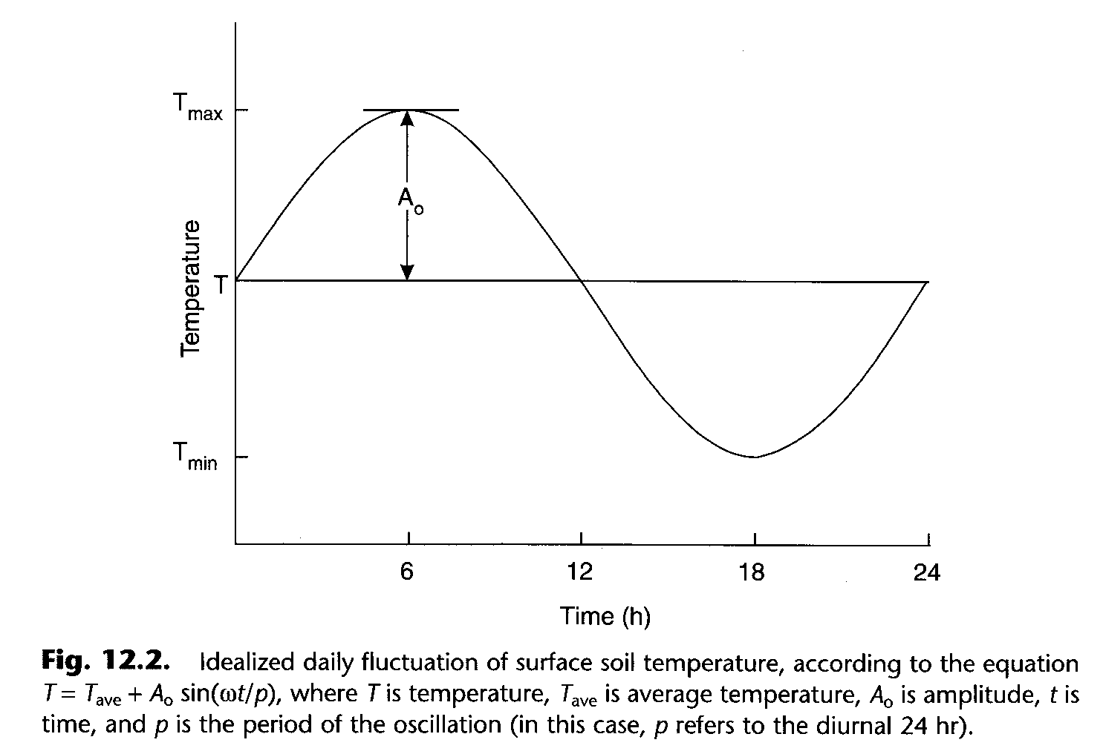

Slide 36
Diurnal fluctuations of soil temperature at 6 cm depth in a silt loam soil in southeast Minnesota under perennial vegetation.

Slide 37
Modeling soil temperature
assuming that:
  surface temperature is (and has been) oscillating as a sine wave
  T_{ave} is the same for all depths
  deep in the soil T is constant at T_{ave}
then soil temperature at any depth is:

Slide 38
Modeling soil temperature
the soil temperature is described by:
z = depth (m)
d = damping depth = (2D_{T}/ω)^{1/2}
φ = phase constant

Slide 39
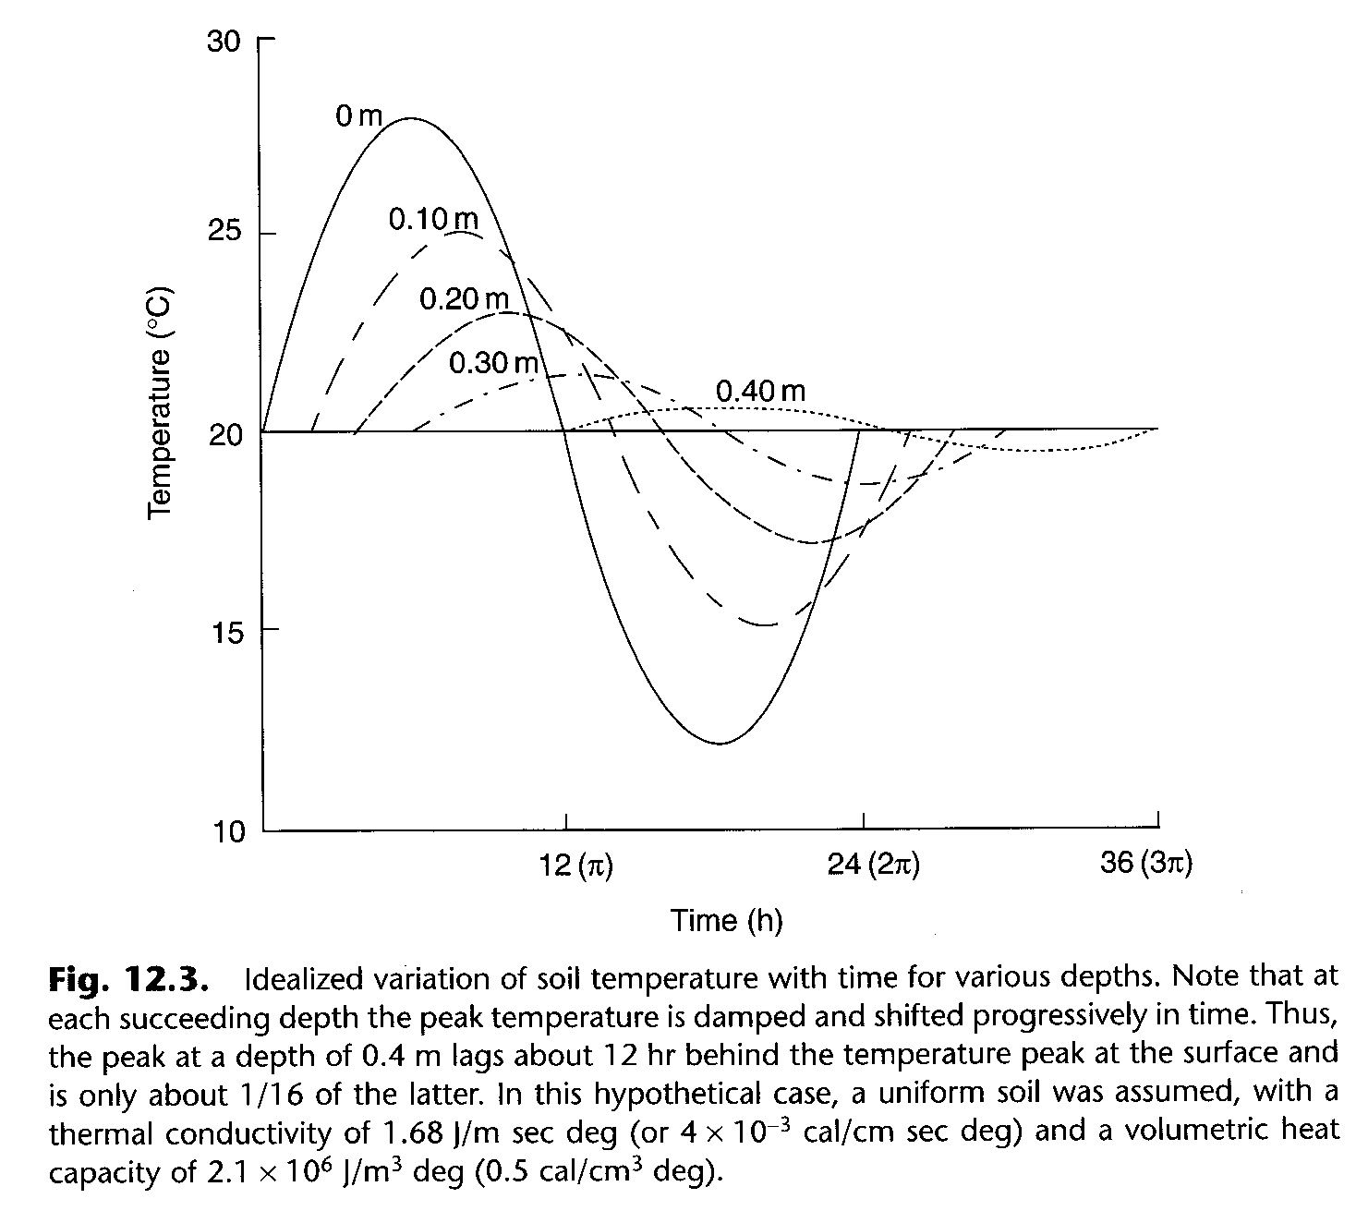

Slide 40
Annual cycle of soil temperature at 1 m depth in a silt loam soil in southeast Minnesota under perennial vegetation.

Slide 41
Damping depth
the soil depth at which the temperature wave amplitude is 1/e (1/2.718 = 0.37) of that at the surface
d = damping depth = (2D_{T}/ω)^{1/2}

Slide 42
Damping depth
Thermal diffusivity, D_{T} = 0.5 x 10⁻⁶ m² s⁻¹
What is the damping depth for the diurnal temperature wave?
What is the damping depth for the annual temperature wave?
At what depth is the amplitude of the annual temperature wave only 5% of the amplitude of the annual wave at the surface?

Slide 43
Time lag
if the soil temperature is described by:
then the time lag between two depths is

Slide 44
Time lag
Thermal diffusivity, D_{T} = 0.5 x 10⁻⁶ m² s⁻¹
What is the time lag between the occurrence of the daily maximum temperature at the surface and at 30 cm depth?

Slide 45
On-line software
http://soilphysics.okstate.edu/

Slide 46
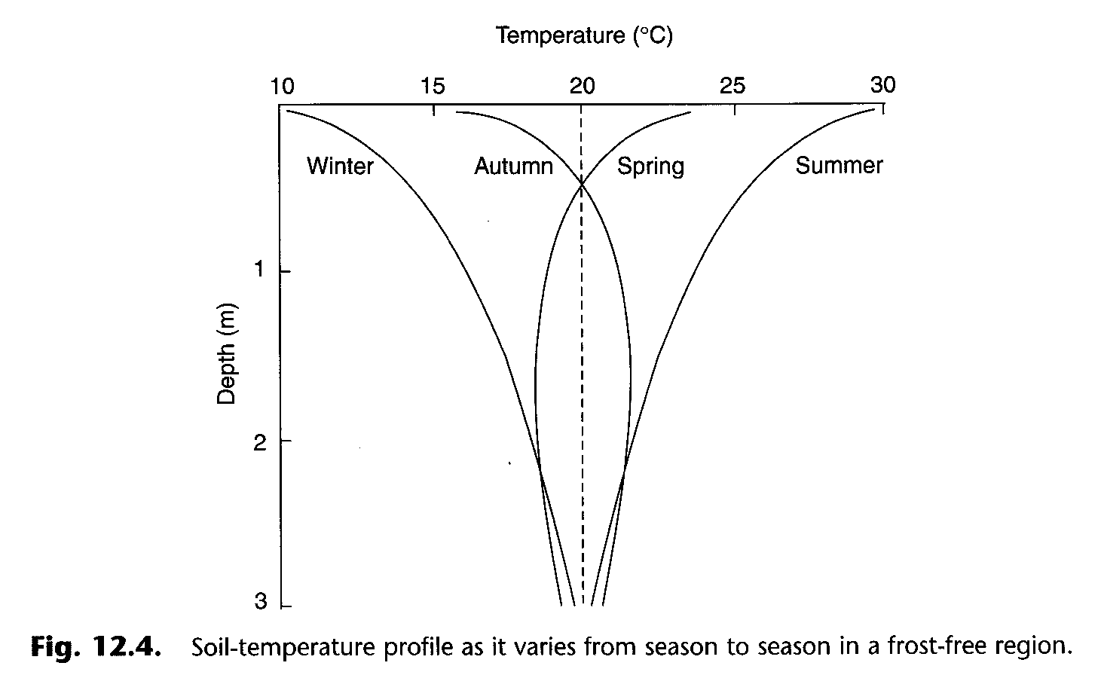

Slide 47
