Slide 1
Soil water fundamentals

Slide 2
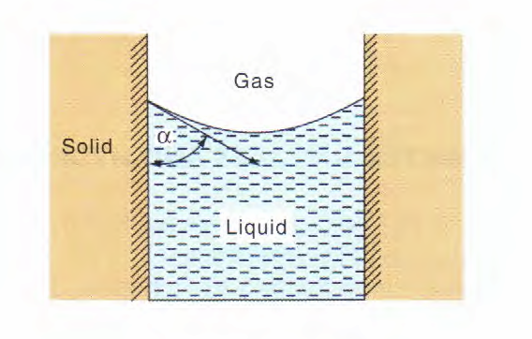
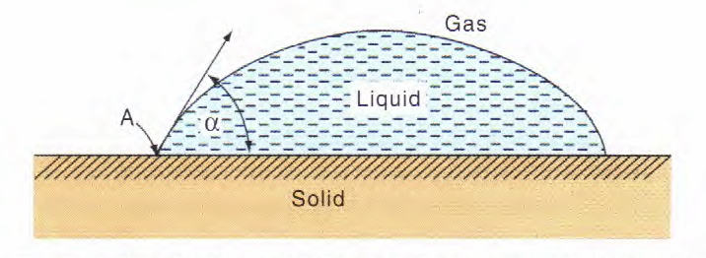
Contact angle
the angle at which a liquid-vapor interface meets a solid surface

Slide 3
Contact angle
Ranges from
minimum of 0° for water on clean smooth minerals
maximum of 180° for a completely water repellent surface
surfaces with contact angles > 90° are called hydrophobic
Depends on
surface tension of the liquid
relative affinity of the surface for the liquid

Slide 4
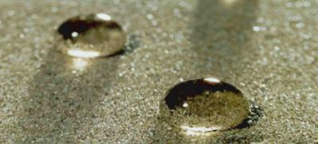
http://ralph.swan.ac.uk/hydrophobicity/soil_hydrophobicity.htm

Slide 5
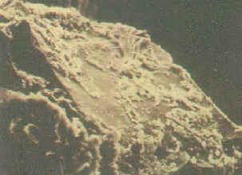
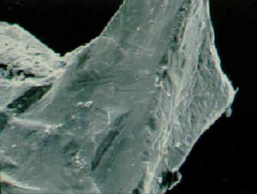
Sand grains with and without organic coatings
http://www.agcsa.com.au/static/atm_articles/html/4_6b.html

Slide 6
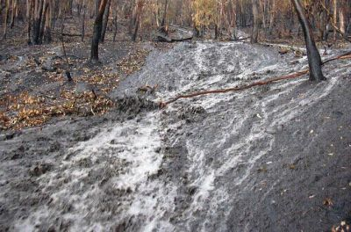
Soil hydrophobicity can enhance overland flow particularly after wildfire as seen here in a burnt Eucalypt forest in Australia (photo: courtesy of Rob Ferguson)
http://ralph.swan.ac.uk/hydrophobicity/soil_hydrophobicity.htm

Slide 7
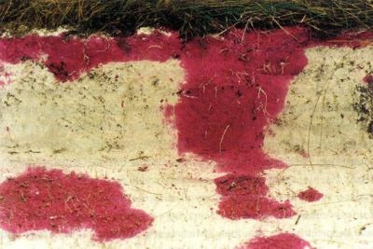
Soil hydrophobicity can enhance preferential flow (as indicated by a tracer in this sandy soil), leading to accelerated contaminant transfer (photo: courtesy of L.W.Dekker)
http://ralph.swan.ac.uk/hydrophobicity/soil_hydrophobicity.htm

Slide 8
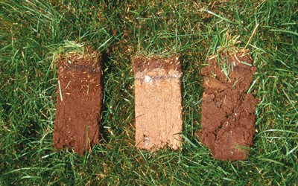
“Localized dry spot”
Hydrophobic zone created by excessive thatch and fairy ring mycelium. PHOTO BY ROB GOLEMBIEWSKI, OREGON STATE UNIVERSITY.
http://www.turfmagazine.com/print-7012.aspx
Turf discoloration resulting from patches of hydrophobic soil on a golf course in Wisconsin
http://bullseyegreensblog.blogspot.com/2011/07/pump-house-down.html

Slide 9
Does soil water repellency play a role in woody plant encroachment?
Robinson, D.A., I. Lebron, R.J. Ryel, and S.B. Jones. 2010. Soil water repellency: A method of soil moisture sequestration in pinyon-juniper woodland. Soil Sci. Soc. Am. J. 74:624-634.

Slide 11
Capillarity
the action which elevates or depresses the surface of a liquid where it is in contact with a solid (e.g. a capillary tube)

Slide 12
Fluid pressures in a capillary

Slide 13
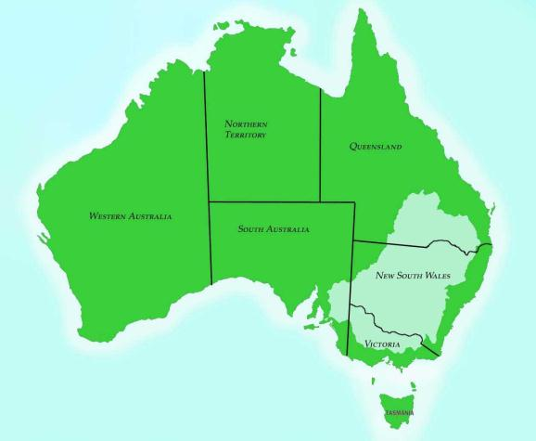
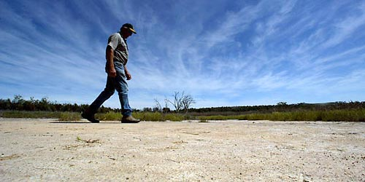
Salinity crisis in the Murray-Darling Basin, Australia
“When groundwater levels are close to the soil surface, capillary action carries salt upward to the plant root zone causing land to become saline. Streams and rivers become saline through salt being washed from the soil surface or where groundwater levels with high salt loads, begin to permanently intersect with the base of the stream or river.”
Reduction in water resources Reduction in agricultural land Damage to urban infrastructure Constraints and losses to industry Reduction in biodiversity Degradation of aesthetics of the landscape

