Slide 1
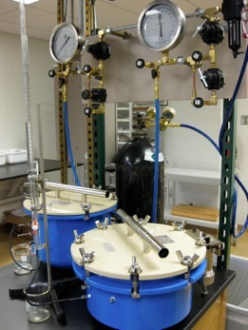
Soil water retention curve

Slide 2
Soil water retention curve
The relationship between soil matric potential and soil water content
“matric suction” = - soil matric potential
Usually soil volumetric water content is used
Usually determined based on empirical data
Sometimes called by other names
Soil moisture characteristic curve
Soil moisture release curve
Etc...
When ψ_{m} = 0, the soil is saturated

Slide 3
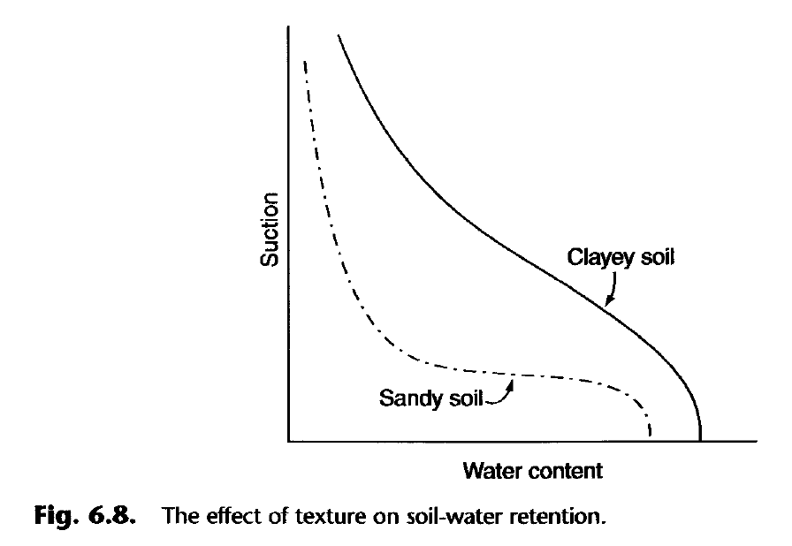
Insert 6.8

Slide 4
Air-entry suction, ψ_{e}
the critical value at which the largest surface pore begins to empty
Coarse textured or well-aggregated soils
Small ψ_{e}
Sharp changes in water content near ψ_{e}
Fine textured or poorly-aggregated soils
Larger ψ_{e}
Gradual changes in water content near ψ_{e}

Slide 5
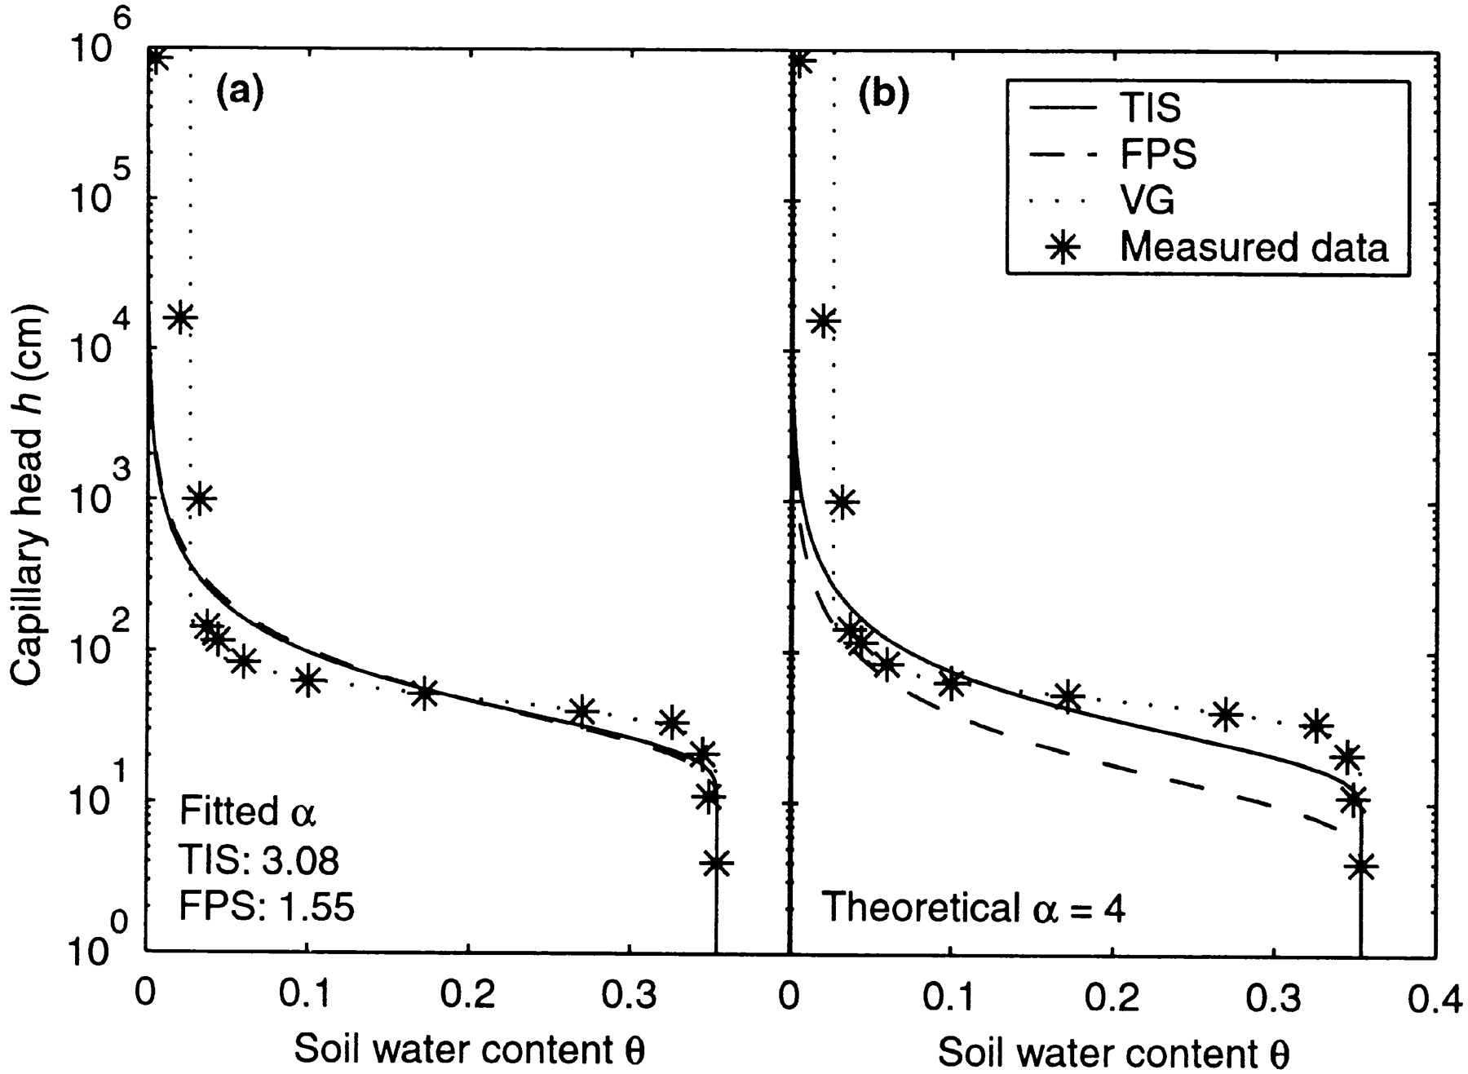
Chan, T.P., and R.S. Govindaraju. 2004. Estimating soil water retention curve from particle-size distribution data based on polydisperse sphere systems. Vadose Zone J. 3:1443-1454.
The measured and estimated soil water retention curves of Troup loamy sand (code no. 1012) (a) with fitted α and (b) with theoretical α. The fitted α value is higher than the theoretical one. TIS, totally impenetrable spheres model; FPS, fully penetrable spheres model; and VG, van Genuchten model

Slide 6
Reading assignment
Soil water retention
p. 116-123
Hysteresis and Measurement of Soil-Moisture Potential

Slide 7
Hysteresis
Desorption curve: an initially wet soil is dried by applying increasing amounts of suction.
Sorption curve: an initially dry soil is gradually wetted by reducing the suction.
Hysteresis is the phenomenon when the desorption and sorption curves differ.
From the Greek husterēsis, a shortcoming,
from husterein, to be late
θ for a given matric suction during sorption “comes short” of θ during desorption

Slide 8
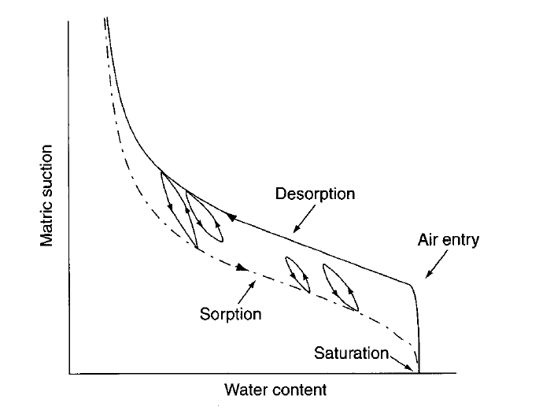

Slide 9
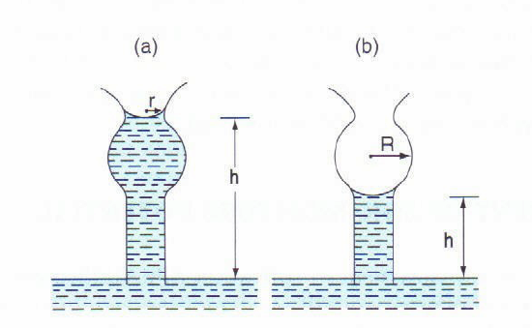
Causes of hysteresis
Nonuniform shape of individual pores: “ink bottle” effect

Slide 10
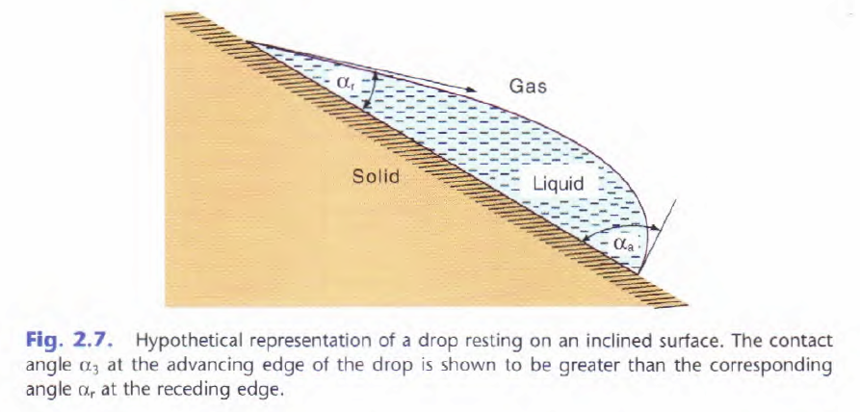
Causes of hysteresis
Contact angle hysteresis: contact angle is greater during wetting

Slide 11
Causes of hysteresis
Entrapped air
Changes in soil structure: shrink-swell, etc…

Slide 12
Factors influencing soil water retention
Soil structure (ρ_{b}, aggregate size distribution)
important at low suctions, 0 to 50 kPa
*Note: 1 kPa = 10.2 cm H₂O at 4°C
Capillary effects

Slide 13
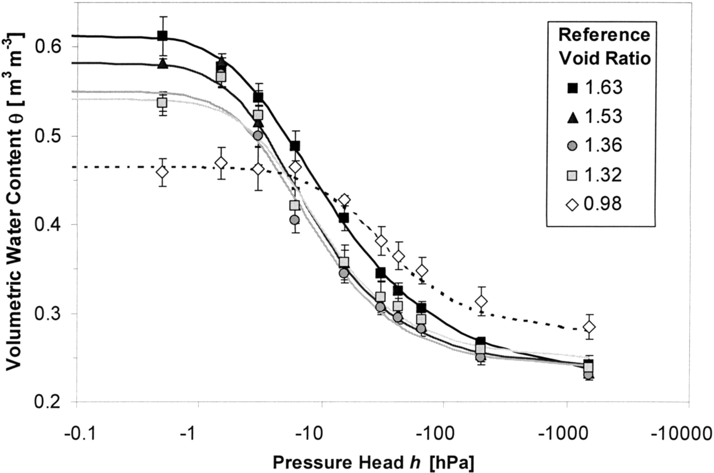
Stange, C.F., and R. Horn. 2005. Modeling the soil water retention curve for conditions of variable porosity. Vadose Zone J. 4:602-613.
Insert 6.9
Comparison of measured and fitted water retention curves for homogenized soil samples from the Stagnic Chernozem A_{h} horizon (Hildesheim site) involving five different reference void ratios between 0.98 and 1.63 at saturation.

Slide 14
Factors influencing soil water retention
Soil structure (ρ_{b}, aggregate size distribution)
important at low suctions, 0 to 50 kPa
Capillary effects
Clay content
Positively related to surface area of soil particles
Positively related to water adsorption
Dominant factors at high suctions

Slide 15
Insert 6.8

Slide 16
Factors influencing soil water retention
Soil structure (ρ_{b}, aggregate size distribution)
important at low suctions, 0 to 50 kPa
Capillary effects
Clay content
Positively related to surface area of soil particles
Positively related to water adsorption
Dominant factors at high suctions
Soil organic matter
Reduces ρ_{b}
Increases water retention at low suctions

Slide 17
Models of soil water retention
Brooks and Corey (1966)
θ_{r} = residual volumetric water content (at high suction)
θ_{s} = saturated volumetric water content
ψ_{e} = air entry suction
λ = pore size distribution index

Slide 18
Models of soil water retention
Van Genuchten (1980) (cited >3000 times)
α = fitting parameter inversely related to ψ_{e}
n = fitting parameter which affects the shape of the curve
m = fitting parameter often fixed as m = 1 – 1/n

Slide 19
Measuring soil water retention curves
Hanging water column
Tempe cells
Pressure plates
http://web.ku.edu/~soil/Facilities_files/IMG_0141.jpg
http://www.ictinternational.com.au/images/extractor1400-2.gif

Slide 20
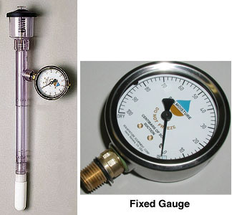
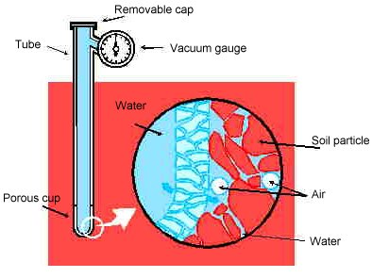
Monitoring soil matric potential: tensiometer

Slide 21
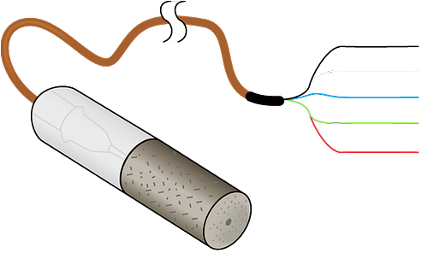
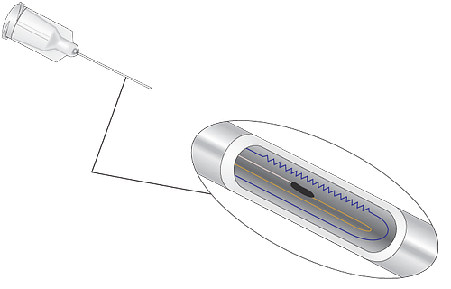
Monitoring soil matric potential: heat dissipation sensor
Campbell Scientific, Inc. 229 Heat dissipation sensor

Slide 22
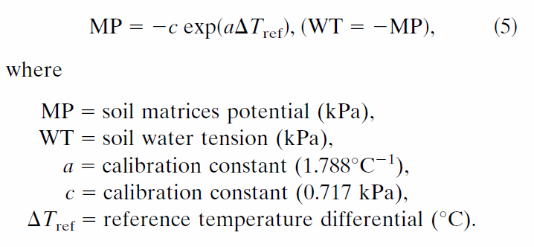
Estimating soil water content using the Mesonet’s CSI 229 sensors
Step 1: convert sensor reading to matric potential

Slide 23
Estimating soil water content using the Mesonet’s CSI 229 sensors
Step 2: convert matric potential to soil volumetric water content using van Genuchten’s equation
α = fitting parameter inversely related to ψ_{e}
n = fitting parameter which affects the shape of the curve
m = fitting parameter often fixed as m = 1 – 1/n

Slide 24
Reading assignment
Laminar Flow and Darcy’s Law, p. 127-136
Homework 3 due Wednesday, Oct. 10

