Slide 1
Introduction to HYDRUS-1D
SOIL 6010
September 2011
T.E. Ochsner

Slide 2
HYDRUS-1D
Linear finite element model
Numerically solves Richards’ equation for saturated and unsaturated flow
Numerically solves advection-dispersion equations for heat and solute transport
Includes sink term to simulate root water uptake
Can simulate gaseous diffusion
Can simulate numerous reactions

Slide 3
Primary developer
Jirka Simunek
Ph.D., 1993, Czech Academy of Sciences, Prauge
USDA ARS, US Salinity Laboratory, 1992-?
with van Genuchten
University of California-Riverside, presently

Slide 4
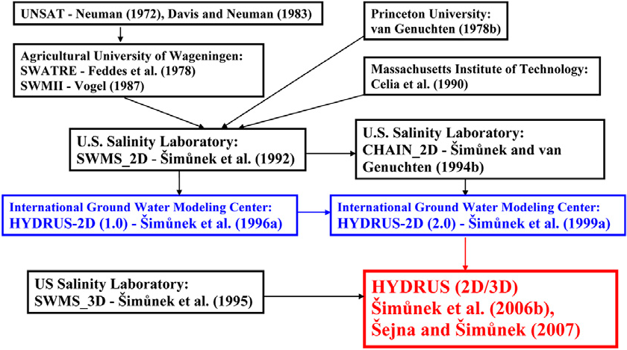
History of development of HYDRUS and related software packages. Software packages supported by graphical user interfaces are in color (2D, blue; 2D/3D, red).
Simunek, J., M.T. van Genuchten, and M. Sejna. 2008. Development and applications of the HYDRUS and STANMOD software packages and related codes. Vadose Zone J. 7:587-600.10.2136/vzj2007.0077.

Slide 5
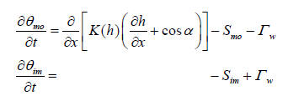
Partial list of governing equations
Uniform water flow
Coupled liquid and vapor flow
Dual-porosity

Slide 6
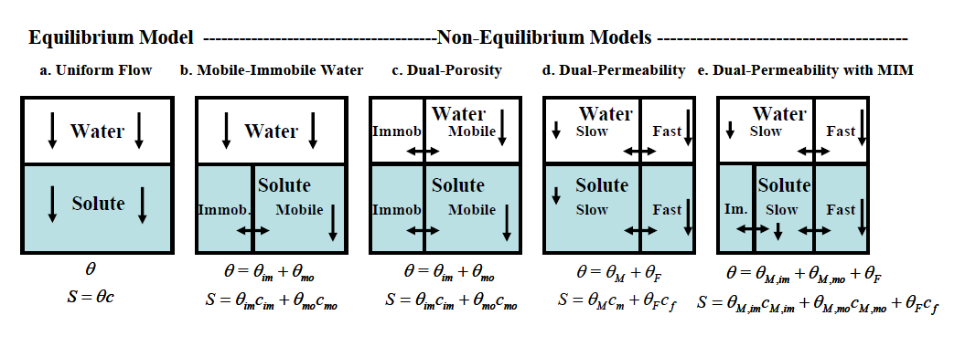
Physical nonequilibrium models

Slide 7
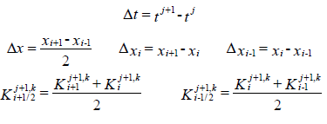
“Mass-lumped finite element scheme”
Leads to an equivalent finite difference scheme

Slide 8
Obtaining and Installing HYDRUS-1D
Go to: http://www.pc-progress.com/en/Default.aspx?H1d-downloads
Download latest version (4.14 currently)
Extract files from self-extracting archive to a temporary directory.
Run “setup.exe” from that directory

