Slide 1
Introduction to Matlab
T.E. Ochsner
2011

Slide 2
Getting Started with Matlab
http://www.mathworks.com/videos/matlab/getting-started-with-matlab.html

Slide 3
OSU Matlab Site License
E-mail Gary Hoefar in the IT Dep. gary.hoefar@okstate.edu
Request access to download and activate Matlab.
After you get Gary’s response, go to http://www.mathworks.com/
Create an account using the same name and e-mail you gave Gary.
Download, install, and activate the appropriate version for your operating system
  Current release is R2011a

Slide 4
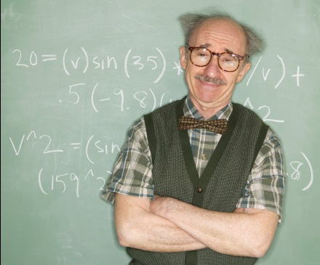
Weak traceability
Record data in field or lab book
Import the transformed data into SigmaPlot
Enter data in Excel
Enter some parameters in Excel
Create some figures in SigmaPlot
Perform some calculations
Copy and paste the SigmaPlot figures in your thesis
Copy and paste the tranformed data into a convenient format for SAS
Import the transformed data to SAS and do some more calculations
Enter the SAS output into a table in your thesis

Slide 5
Improved traceability
Record data in field or lab book
Create raw data file in .csv, .xlsx, or other format
Create Matlab script to process the data, generate figs, and run stats.
Copy and paste the Matlab figures and stats into your thesis.

Slide 6
Weak graphics

Slide 7
Improved graphics

Slide 8
Customization
  function theta_vg = vangenuchten(vgparams, matric)
  %VANGENUCHTEN returns the estimated water content vector corresponding to
  %the input vectors containing the matric potential and the function
  %parameters. The units of the matric potential and the units of the
  %parameter "alpha" must cancel.
  theta_s = vgparams(1); %saturated water content
  theta_r = vgparams(2); %residual water content
  n = vgparams(3); %shape factor
  alpha = vgparams(4); % inverse of air entry potential
  %m = 1 - 1/n;
  m = vgparams(5);
  theta_vg = ((1+(-alpha*matric).^n).^(-m))*(theta_s - theta_r) + theta_r;

Slide 9
Efficiency and Speed
Excel spreadsheet with 10⁶ data points = 8.8 Mb
Matlab data file with 10⁶ data points = 0.4 Mb
“Consider the problem of inverting the covariance matrix of a first-order autoregressive process with dimension n=1000 and correlation parameter 0.5 and unit innovation variance…. PC with a 400 MHz Pentium II processor running WinNT with 256 MB RAM.”
Program | CPU Time in Seconds
Mathematica, uncompiled | 127
Mathematica, compiled | 99
R | 77
MatLab V.5.3 R11 | 48
S-Plus Version 5.2 | 109
C++ | 98
Fortran | 79
http://www.stats.uwo.ca/faculty/aim/epubs/MatrixInverseTiming/default.htm

Slide 10
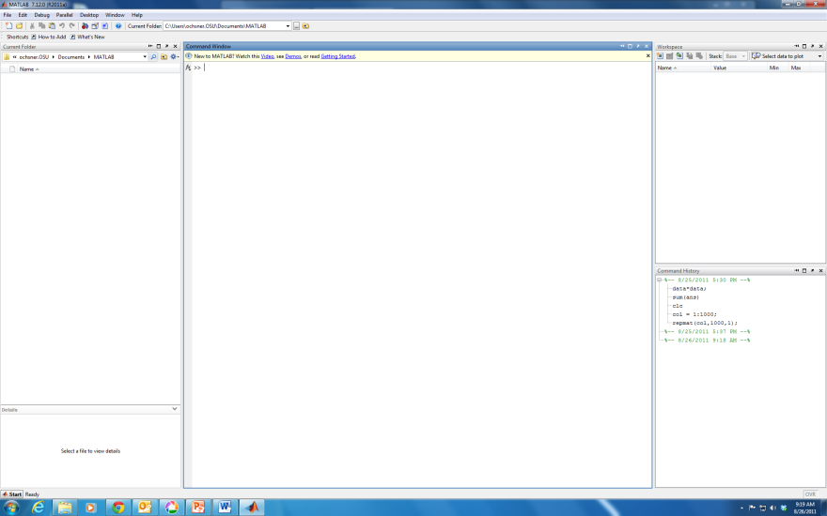

Disadvantages of Matlab
Harder to learn than Excel
Weaker on statistics than SAS
  For example: no built-in “repeated measures” procedure

