Slide 1
Soil Physics—Past, Present, and Future

Slide 2
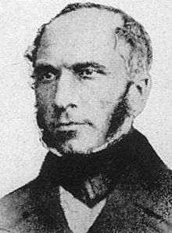
Henry Darcy
France
Engineer
Water delivery and treatment
Darcy’s Law for saturated flow in porous media (1856)
See Dr. Glenn Brown’s website for additional information.
http://biosystems.okstate.edu/darcy/index.htm
http://no.wikipedia.org/wiki/Henry_Darcy

Slide 3
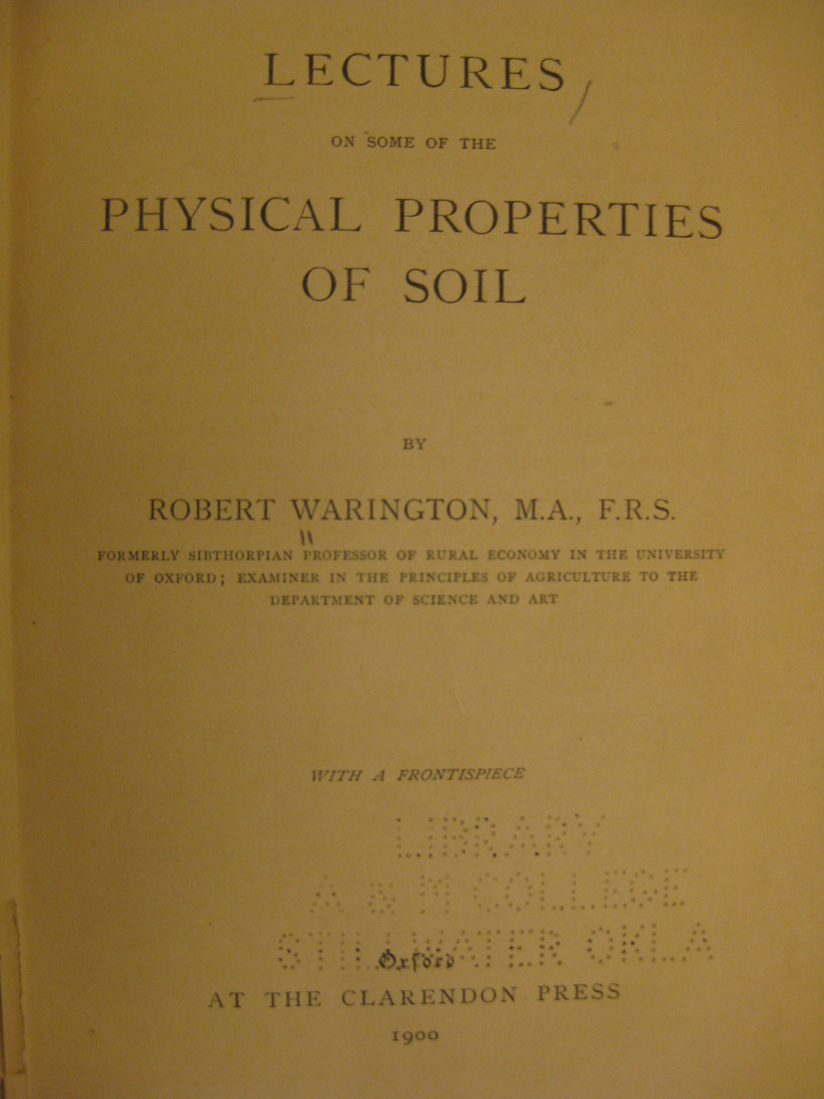
Robert Warington
England
Professor of Rural Economy
First soil physics book, 1900

Slide 4
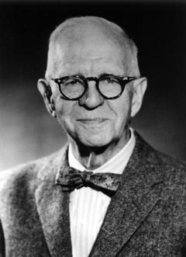
Lyman Briggs
United States
Physicist, USDA Bureau of Soils
“The mechanics of soil moisture”, 1897
Three types of water
  Gravitation
  Capillary
  Hygroscopic
Head of “The Uranium Committee”, 1939
Lyman James Briggs, 1874-1963
Source: http://www.nap.edu/readingroom.php?book=biomems&page=lbriggs.html

Slide 5
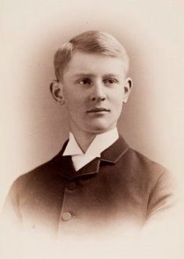
Edgar Buckingham
United States
Physicist, Bureau of Soils
“Studies on the movement of soil moisture”, 1907
  Introduced “capillary potential”, “conductivity”, and moisture diffusivity
  Showed that capillary potential and conductivity were functions of soil moisture
  Extended Darcy’s law to unsaturated flow
Buckingham Π-theorem of dimensional analysis
Edgar Buckingham, 1867-1940
Source: http://en.wikipedia.org/wiki/Edgar_Buckingham

Slide 6
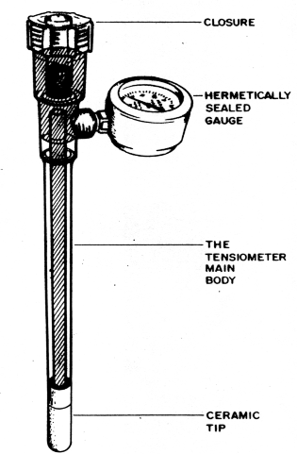
Willard Gardner
Utah State Univ.
Physicist
Developed the tensiometer, 1922
Developed first pde for horizontal, unsaturated flow, 1920
Introduced Don Kirkham and many others to soil physics
http://web.idrc.ca/fr/ev-42826-201-1-DO_TOPIC.html

Slide 7
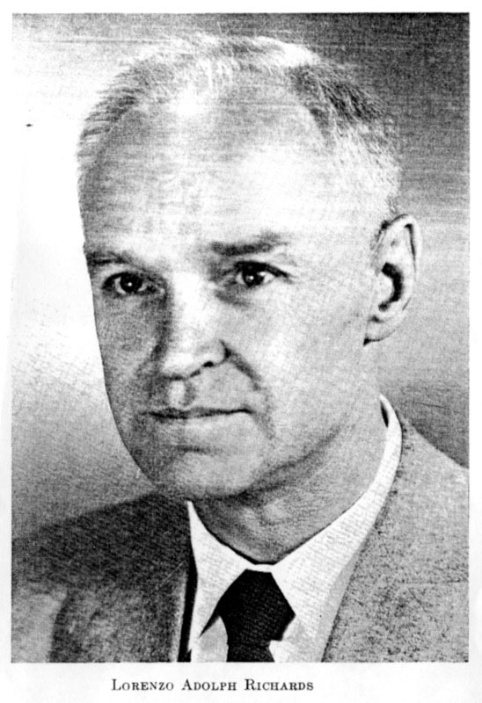
Lorenzo Richards
Utah State Univ., Iowa State Univ., and USDA Salinity Lab at Riverside, CA
Physicist
“Capillary conduction of liquids through porous mediums”, 1931
  Introduced the Richards equation still used today
Later helped define “field capacity” and “permanent wilting point”
http://www.hydrowiki.psu.edu/wiki/index.php/Richards,_L.A.

Slide 8
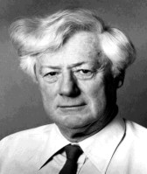
John R. Philip
Australia
Civil Engineer
“The theory of infiltration”, seven papers, 1957-58
  Pioneered analytical solutions for infiltration
“Moisture movement in porous materials under temperature gradients”, 1957 with de Vries
John R. Philip, 1927-1999
http://www.bgu.ac.il/cwst/transport.htm

Slide 9
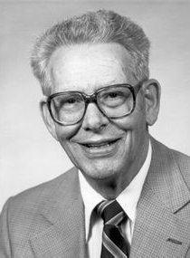
Don Kirkham
Iowa State University
Joint appointment in physics and in soils
Pioneered the application of soil water theory to agricultural drainage, 1950-1970
Developed method to determine soil moisture by neutron scattering with Wilford Gardner
Namesake of the annual Kirkham Award
Don Kirkham, 1908-1998

Slide 10
Don and Betty Kirkham Award Recipients
Year | Name | Institution | Research highlights
1998 | Rien van Genuchten | USDA Salinity Lab | Soil hydraulic functions
1999 | Bill Jury | UC Riverside | Transfer function models
2000 | Brent Clothier | HortResearch, NZ | Field measurement techniques
2001 | Dani Or | Utah State, Uconn, and now ETH, Zurich | Pore scale phenomena
2002 | Bob Horton | Iowa State Univ. | Coupled heat, water, and solute transport
2003 | Jan Hopmans | UC Davis | Lab techniques for soil hydraulic characterization
2004 | Laj Ahuja | USDA Fort Collins | Root Zone Water Quality Model
2005 | Jirka Simunek | UC Riverside | HYDRUS
2006 | Per Moldrup | Aalborg Univ., Denmark | Gas diffusion
2007 | Yakov Pachepsky | USDA Beltsville | Pedotransfer functions

Slide 11
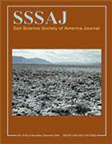




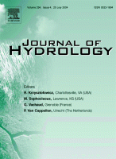
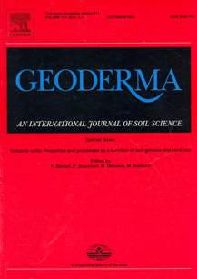
Where do soil physicists publish?

Slide 12
The Future of Soil Physics
?

